Slide 1
Evolution of Complex Systems
Lecture 1: Introduction
Peter Andras peter.andras.ncl@gmail.com
2022 Edition

Slide 2
Objectives
Topics of interest:
Biological evolution
Evolution of the education system
Advances in computer programming

Slide 3
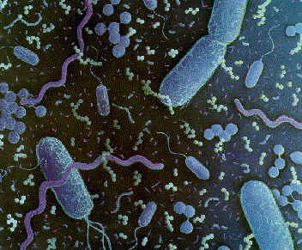
Bacteria
Unicellular organisms, most of the genome is made up of protein encoding sequences

Slide 4
Medusa
Multi-cellular filter feeders with tissues and organs
(www.junglewalk.com)

Slide 5
Mouse
Many tissues organised in a wide range of organs
(www.junglewalk.com)

Slide 6
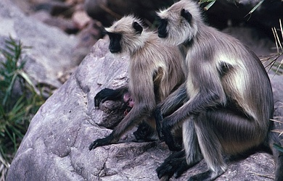
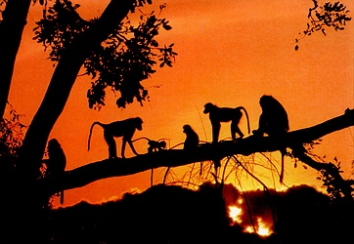
Monkeys
Complex animals with some social structure
(www.junglewalk.com)

Slide 7
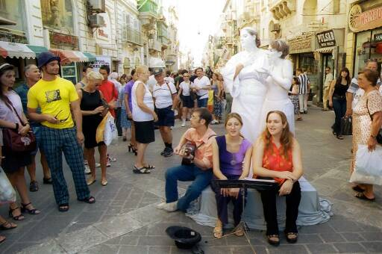
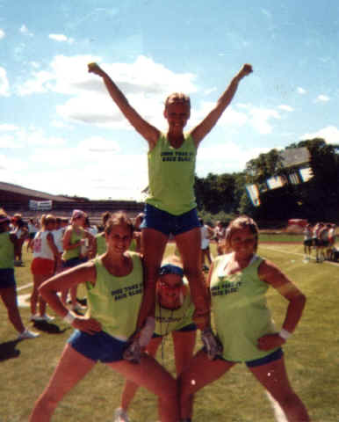
Humans
Complex animals with extensive social structure
(www.maltavista.net)
(www.johnmcmullin.com)

Slide 8
What are the common features ?
What are common in various biological systems: genes, cells, tissues, organs, organisms ?

Slide 9
What drives the evolution of biological systems ?
How did we develop from bacteria ?
How can we describe the evolution of biological systems ?

Slide 10
What are the boundaries of evolutionary units ?
Are the units of evolution cells, tissues, organisms ?
Consider bacteria, cat, cancer, ant colony, etc.

Slide 11
How can we link biological and social systems ?
Complex social systems: humans, monkeys, bees, ants
Simpler social systems in other animals
How do social systems emerge from interaction of biological systems

Slide 12
What is the role of communication and information ?
Genes, proteins, nervous system

Slide 13
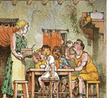
Education as family socialisation
Ancient times to middle ages: learning at home as part of regular socialisation
(atschool.eduweb.co.uk)

Slide 14
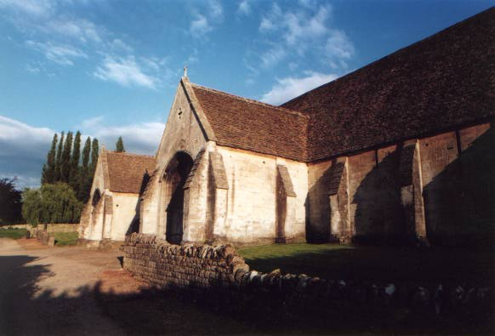
Literacy and numeracy
Few schools in the middle ages
Schools related to churches
Schooling usually guaranteed a position in church or governmental administration
(members.lycos.co.uk/RobertSlade/Gallery)

Slide 15
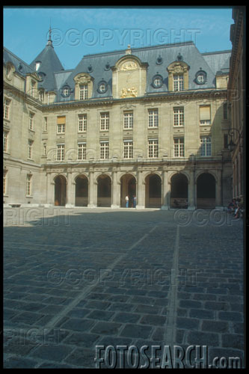
Early universities
Middle ages: Italian cities, Paris, Cambridge, Oxford, Prague, etc.
Focused on theology later on law and medicine

Slide 16
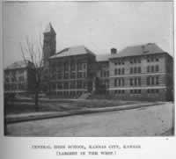
Trade schools
17th – 19th century
Training in specific areas
Commerce schools, technical schools
(www.kckps.org)

Slide 17
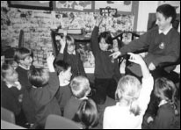
General elementary education
Late 19th – 20th century
Basic education (literacy, numeracy) for everybody
Basic education in some sciences (e.g., geography, biology)
(www.ethosnet.co.uk)

Slide 18
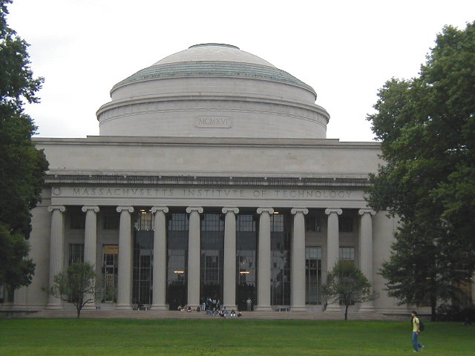
Modern universities
Late 19th – 20th century
Organised around research and sciences
Advanced level training in sciences
(azfoo.net)

Slide 19
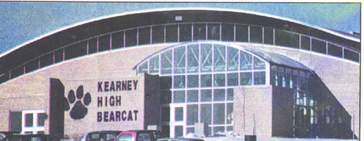
GCSE and A - levels
Mid-late 20th century
Standardised education and exams
Almost general secondary education
(userweb.esu10.k12.ne.us/~kearney)

Slide 20
Layered university system
Mid 20th century
German system: vocational, technical and science universities
American system: community colleges, state universities, research universities
British system: further education colleges, polytechnics, universities

Slide 21
Graduate schools
Mid – late 20th century
Formal education at post – graduate level
Advanced training in scientific research
(www.wfu.edu/physics)

Slide 22
Changes of the education system
What drives these changes from one system to another ?
How did we develop graduate schools from church related basic literacy and numeracy schools ?

Slide 23
What comes next ?
Can we predict how the education system will change in the future ?
What are the likely new forms of education ?

Slide 24
Economics, politics, education
How does economics and politics interact with the education system ?
How is this interaction influencing the evolution of the education system ?
How does the change of the education system influence economics and politics ?

Slide 25
Information and communication
What is the role of information and communication within the education system ?
How do information and communication shape the evolution of the education system ?

Slide 26
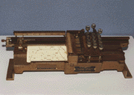
Punch cards
40s-50s
Early computers – early programs
Very hard to program
Bad joke: playing cards with them
(www.csis.american.edu/museum)

Slide 27
FORTRAN and COBOL
Late 50s – early 70s
Early advanced programming languages
Contained the basic programming structures
E.g., for cycle, if – then – else, sub-routine
It was still difficult to write easy-to-understand programs

Slide 28
Pascal, Ada, C
70s – 80s
Structured programming languages
They allow easier programming
Structured sub-units: procedures and functions
Better management of variables
The programs are more readable by non-authors

Slide 29
OOP
80s – 90s
C++, Delphi, Eiffel, Smalltalk, Java
Encapsulation and inheritance
Advanced management of variables and sub-units
Re-usability and readability by non-author

Slide 30
Component-based programming
Since mid – late 90s
MFC, STL, design patterns
Very easy programming
High level of re-usability
Easy to read by non-author
Dumbing down of programming

Slide 31
Further concepts
Reflection
Self-modification (e.g. aspect-oriented programming)
Development frameworks (e.g. Spring, Spark, Wicket, Grails, Hibernate, JSF)
Low – coding / No – coding

Slide 32
From punch cards to component based programming
Why did this evolution happened ?
What are the driving forces behind ?

Slide 33
Is this good ?
Is it good that we evolved from the art of programming to dumbing down of programming ?
Are we more efficient now than at the beginning ?

Slide 34
What comes next ?
What will happen in the area of computer languages ?
What will be the next big thing in computer programming ?

Slide 35
Information and communication
What is the role of information and communication in the evolution of programming ?

Slide 36
Systems evolution
How can we describe such complex systems ?
How can we describe and analyse the evolution of complex systems ?
What is the role of information and communication in the evolution of various systems ?

Slide 37
Summary
Evolution from cells to social systems of humans
Evolution of the education system
Evolution of computer programming
How to describe and analyse the evolution of complex systems ?

