Slide 1
Evolution of Complex Systems
Lecture 2: Definition of Systems
Peter Andras peter.andras.ncl@gmail.com
2022 Edition

Slide 2
Objectives
Examples of systems
Fundamental concepts:
Communication
Environment
Action and perception
Reference
Main function of systems

Slide 3
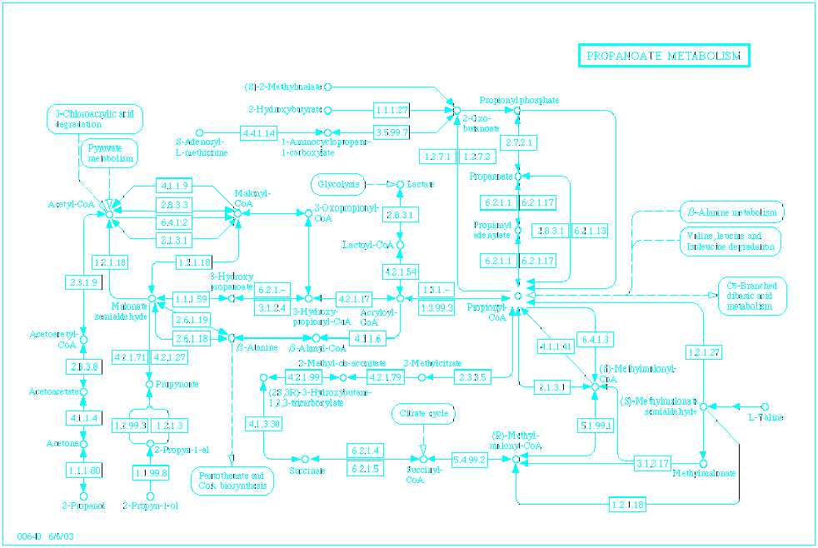
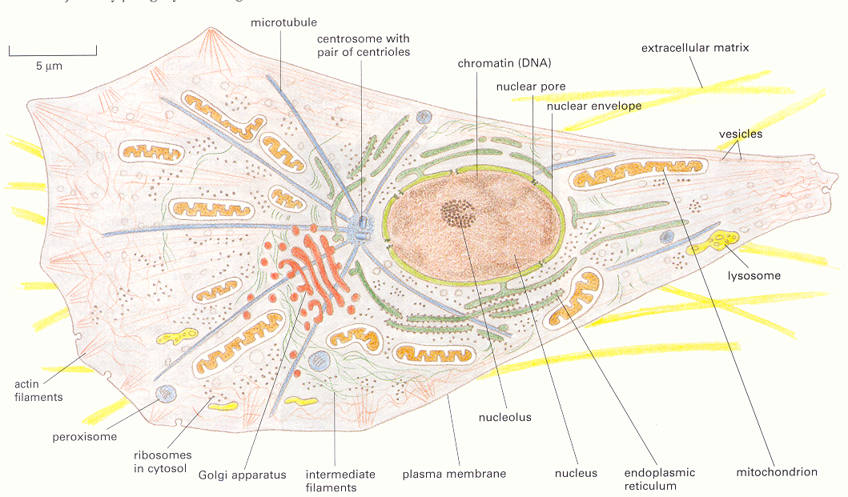
The cell
Complex system of many cellular organelles
System of interacting proteins

Slide 4


Medusa
Filter feeder organism with tissues and organs
(www.junglewalk.com)

Slide 5

Mouse
Complex organism with many tissues and organs
(www.junglewalk.com)

Slide 6
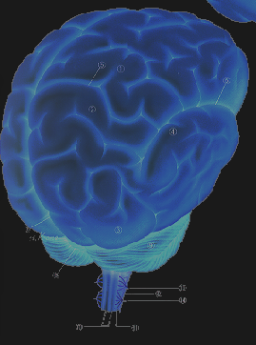
The nervous system
Complex network of specialized cells (neurons) dealing with the information processing of an organism

Slide 7
The conscious self
A system communicating about the identity of the self

Slide 8
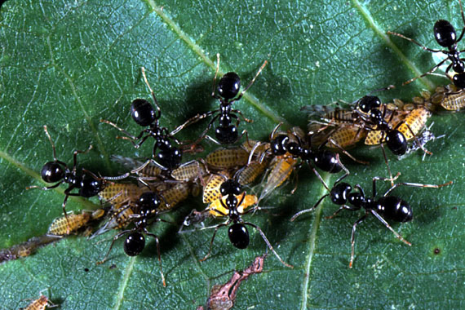
Ant colony
Many communicating individual organisms form a complex system together
(research.amnh.org/entomology)

Slide 9


Political system
The system of human communications about how to distribute and use power within the society
(www.janes.com)
(depthome.sunysuffolk.edu)

Slide 10

The Windows OS
Large system of many software processes (programs) that communicate with each other

Slide 11
Communication – the concept
Sender Signal Receiver

Slide 12
Sender and receiver
Sender and receiver: communication units that can send and receive signals
Their key feature is that they can communicate with each other
We ignore their inner structure
E.g., two mobile phones

Slide 13
Signal
Signal = a behaviour or a state of the sender communication unit
E.g., a set of modulated electromagnetic waves generated by a mobile phone

Slide 14
Signal transmission
Signal transmission:
Signal generation by the sender
Signal reception by the receiver
It may involve signal deterioration due to the transmission media
E.g., communication through mobile phones

Slide 15
Communication
Sender unit:
Signals generated
Communication:
Signals transmitted
Receiver unit:
Signals received

Slide 16
Communication – issues not yet discussed
Meaning of communication
Structure of communication: e.g., sequence or pattern of signals

Slide 17
Communication systems – 1
We consider systems as communication systems: set of communication units that exchange communications, the system being the set of these communications
All systems discussed can be seen as communication systems
E.g., nervous system, ant colony, Windows OS

Slide 18

Communication systems – 2
Communication units
Communication system

Slide 19
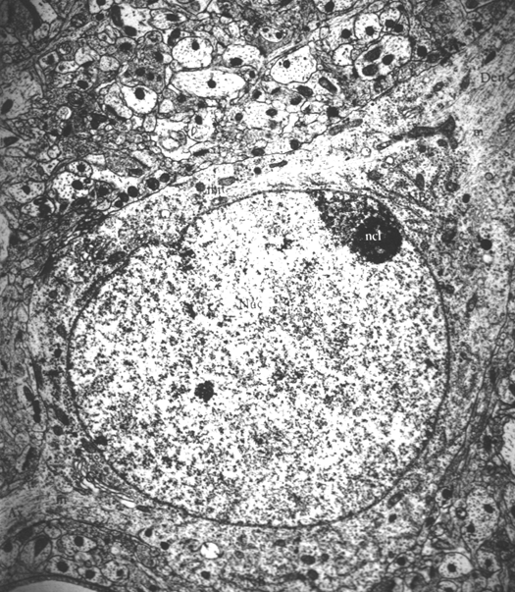
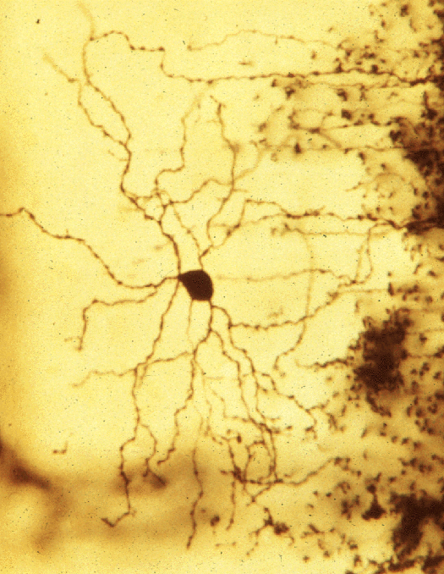
The cell’s environment
(cti.itc.virginia.edu)

Slide 20
Outside of a system
Communications between communication units, which are not part of the system
E.g., mobile phones and satellite TV signals

Slide 21
Environment
Environment = not the system
We define environment as every communication that is outside of the system
E.g., cell and metabolites in the inter-cellular fluid

Slide 22
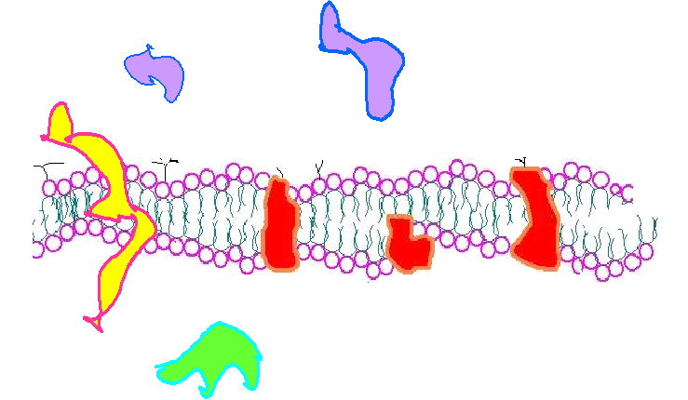
Where is the boundary ?

Slide 23
System and environment
Communication density boundary
Dense communication within the system rare communications with outside of the system
Note: the boundary may change

Slide 24
System – environment interactions 1
System: communications between communication units
The communication units are independent of the system, and they may participate in other communications, which are not part of the system
The behaviour of communication units may be influenced by their participation in outside the system communications
E.g., cordless phone and interference with electronic equipments

Slide 25
System – environment interactions 2
The effects on the behaviour of communication units caused by communications not part of the system inducing modified communications within the system are the effects of the environment on the system
E.g., antibiotics block the proper communications (generation of proteins) within the bacterial cell and cause the destruction of the cell’s system

Slide 26
System actions
Communications within the system happen by behaviour of communication units
Such behaviour modify the participation of these communication units in communications that are part of other systems which make part of the environment of the selected system
In this way the system acts on the environment
E.g., the cat’s movements may warn the mouse

Slide 27
System perceptions
The environment modifies the behaviour of communication units that generate the communications which make the system
The communications within the system change in effect, the system perceiving in this way the environment
E.g., a mouse appears in the sight of a cat

Slide 28
Possibility - concept
In a sequence of communications one communication may be followed by many others, all these are possible communications
The possible communications form the possibility space of continuation for a communication
E.g., cat sees a mouse, may approach it in many ways
E.g., talking to a friend a sentence may be followed by many others

Slide 29
Sequence of communications
Every communication determines the range of possible following communications
E.g., in normal human speech there are rules which determine which sentence may follow a previous sentence

Slide 30
Reference - concept
In a communication system each communication references other communications that are or were part of the system
The communications which are referenced are those, which determine the possibility space from which the current communication is chosen
E.g., talking about a friend to a friend or to a foreign person

Slide 31
Communication systems: probabilistic interpretation – 1
Within a system new communications emerge
The probability distribution of these new communications over the space of possible communications (the current possibility space) describes the system

Slide 32
Communication systems: probabilistic interpretation – 2
Example:
‘The human eye is extremely sensitive.’
A. ‘Researchers, hoping one day to build robots that can see as well as humans, are now trying to copy what is known about the retina onto silicon chips.’
B. ‘Let’s consider the camera for a moment.’
C. ‘They are usually the ones who govern nations.’
How likely are these continuations ?

Slide 33
Communication systems: probabilistic interpretation – 3
Current Possible
0.1 0.05 0.2 0.02 0.03 0.2 0.35 0.05
0.15 0.01 0.1 0.2 0.04 0.3 0.1 0.1
0.2 0.15 0.02 0.3 0.1 0.03 0.15 0.05
0.4 0.01 0.02 0.02 0.35 0.02 0.03 0.15
0.1 0.05 0.2 0.02 0.03 0.2 0.35 0.05

Slide 34
System perceptions – revisited 1
The environment induces changes in the communication units that affect the communications produced by these
Such effects can be seen as a change in the probability distribution of new communications that may emerge, over the space of possible communications
The actual new communications provide a sample of the actual probability distribution
The difference between the expected and the actual distribution represents the perception of the system

Slide 35
System perceptions – revisited 2
Current Possible
Environment
0.1 0.05 0.2 0.02 0.03 0.2 0.35 0.05
0.15 0.01 0.1 0.2 0.04 0.3 0.1 0.1
0.2 0.15 0.02 0.3 0.1 0.03 0.15 0.05
0.23 0.12 0.03 0.25 0.12 0.04 0.12 0.09
0.35 0.06 0.01 0.08 0.31 0.01 0.07 0.11
0.1 0.15 0.1 0.12 0.01 0.12 0.3 0.1

Slide 36
Why do systems exist ?
Communication systems are created by the emergence of dense inter-referencing communications between communication units surrounded by a rare set of communications
Such systems exist by the generation of new communications referencing other earlier communications that are part of the system
Only systems that reproduce and expand can be observed
Systems exist to maintain and reproduce themselves, this is their main function

Slide 37
Do systems have a function ?
From the point of view of an external observer it may appear that the systems has some particular function within a larger system
From inside the single main function of the system is its own reproduction
E.g., communications between bureaucrats

Slide 38
System expansion
Systems main function: self reproduction
Systems that reproduce and expand by attracting more communication units to generate communications that are part of them may dominate other systems
E.g., animals, human organisations

Slide 39
Systems working
Communications systems generate communications that reference other communications that are part of the system
The systems aim to reproduce and expand by generating new communications
The systems generate communications that induce actions upon the environment by modifying the behaviour of communication units that produce the system’s communications
The environment acts upon the communication units, which actions can be perceived by the systems

Slide 40
Summary
Communication
Environment
System boundaries
Action
Perception
Possibility
Reference
Main function of systems

Slide 41
Q&A – 1
Is it true that the economy of North Tyne Side forms a separate system ? Why ?
Is it true that sodium (Na+) ions are part of a cell even outside of the cell membrane ?
Is it true that this lecture is part of the environment for the UK political system ?

Slide 42
Q&A – 2
Is it true that a seminar on human rights with participation of politicians is an action of the legal system on the political system ?
Is it true that measuring the university choice of high school graduates is a perception of the university system about its social environment ?
Is it true that when we talk with our GP we should refer to recent political events in order to be understood ?

Slide 43
Q&A – 3
7. Is it true that we can tell a story about an old friend to a new friend without referencing explicitly anything that is already known by our new friend ?
8. Is it true that the main function of a politician is to represent their constituency ?

