Slide 1
Evolution of Complex Systems
Lecture 5: Organism and nervous system
Peter Andras peter.andras.ncl@gmail.com
2022 Edition

Slide 2
Objectives
Multi-cellular systems
Tissues and organs
Subsystems of organisms
Memory in the organism
Organism identity
Nervous system: the information subsystem of the organism
Adaptation in response to identity violations
Complexity of organisms

Slide 3
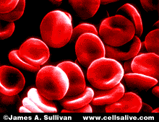
The cell system
Protein – protein and protein – metabolite interactions
Language: spatio-temporal pattern of such molecular interactions
Information subsystem: genome
(www.cellsalive.com)

Slide 4
The cell system from the outside
Communication unit
Communication signals / behaviours:
Expression of a set of proteins in the cell membrane
Release of proteins and other metabolites as secretions
Cell actions

Slide 5
Communication signals between cells
Two cells, both cells communicate by expression and release of molecules
The communication signals are sent by one cell, transmitted to the other cell by diffusion of released molecules or by binding of surface molecules, and received by the other cell through its receptor molecules
E.g., neurons: neurotransmitters, electric junction molecules

Slide 6
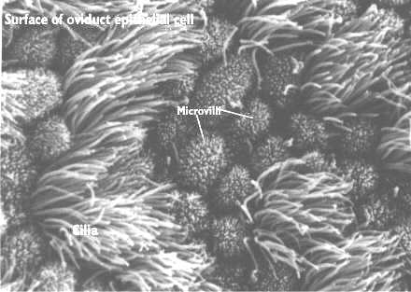
Communication of cells
Cells produce a sequence / pattern of signals
A new signal is determined by the current or recent signals and the signals of other cells received by the cell
Note: we ignore the internal part of the cell, which actually determines the signals produced by the cell
(cellbio.utmb.edu/cellbio)

Slide 7
Rules of cell communications
It is not possible to produce any signal after any other signal
The possible following signals are determined by the interior mechanisms of the cell
From outside we see a conditional probability distribution over the set of all communication signals that can be produced by the cell
E.g., refractory period in neurons that follow spikes

Slide 8
Referencing in cell communications
The new communication depends on earlier communications of the cell and communications of other cells, which are received by the cell
E.g., neurons: inhibition and excitation signals received from other cells

Slide 9
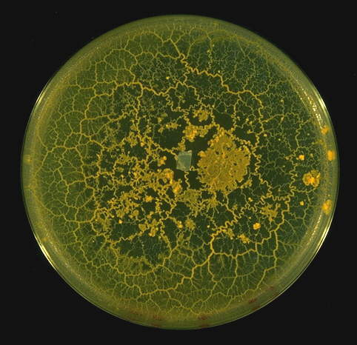
Multi-cellular systems
Many cells which act as communication units
Generate a system of communications between cells = organism
E.g., bacteria biofilms, slime mould, sponges, cat, human
(www.shef.ac.uk/ ~mb1rwa/rwaresea.html)

Slide 10
Simple multi-cellular systems
Cnidarian hydra: inner wall, outer wall, tentacles, foot – few tens of different kinds of cells
Behaviour: filter feeding

Slide 11
The environment of the organism
Anything that is not part of the inter-cellular communication system is part of the environment
Communications with other cells, e.g., digestive bacteria
The boundary is a communicational boundary
Usually the boundary is well-defined as skin and other epithelial surfaces in higher animals

Slide 12
Actions of organisms
Action: a pattern of inter-cellular communications
E.g., extending a tentacle of a hydra
The actions act upon the environment
The communications leading to actions are referenced by other inter-cellular communications

Slide 13
Perceptions of organisms
The environment influences the behaviour of cells and so modifies the conditional probability distributions of cell communications
E.g., a food particle triggers the release of digestive enzymes and the digestion of the food particle by the hydra

Slide 14
Specialized cells
Some communication units (cells) may specialize to produce a limited set of possible communication signals
The specialization means the change of the conditional distributions of continuation signals, i.e., sharpening the distribution
Specialization happens by selection of a part of the genome to be regularly expressed in the cell
Specialization = constraints on inter-cellular communications → structure
E.g., stem cells – generalist cells; muscle cells – specialist cells

Slide 15
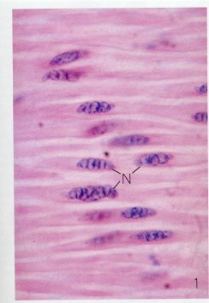
Tissues
Specialized cells form tissues
Tissues usually have a special function within the organism, i.e., they deal with a subset of actions produced by the organism
E.g., muscle, bone, neural tissue
(www.ucd.ie/vetanat/calnet/muscle)

Slide 16
Tissue subsystems
Tissues are formed by specialized cells, which produce preferentially a subset of possible inter-cellular communications – structure constraints
These specific communications define the tissue communication system
E.g., muscle cells communicate with each other about stretching and contracting

Slide 17
Tissue language
The language of a tissue system is a specialized / modified subset of the organism’s language:
The set of conditional probabilities determining which signal follows other signals
The conditional probabilities are sharpened to limit the communications to the tissue specific communications
E.g., muscles: all inter-muscle cell communications are about stretching/contracting

Slide 18
The environment of tissues
Communication boundary: cells within a tissue communicate frequently, relatively rare communications with non-tissue cells
The boundary is within the organism’s system boundary
E.g., nerves and muscles

Slide 19
The function of organisms and tissues
Self-reproduction and expansion of their own communication system
The self-reproduction and expansion of the organism limits the self-expansion and reproduction of it’s sub-systems (tissues)
Implication: size, shape, organisation, location of tissues within the organism

Slide 20
Programmed cell death
Organismal communications limit the growth of tissues
This happens by inducing tissue shaping by limiting growth and programmed cell death
Programmed cell death is the result and mean of limiting tissue specific communications as part of the expansion of the organism’s communications

Slide 21
Cancer
Cancerous cells loose their ability to participate in the tissue and organism communications
They become communication units that communicate mainly between themselves, and reduce their communications with the rest of the organism
The cancer is as independent multi-cellular system that expands disregarding the overall expansion of the organism and the tissue level limits implied by this

Slide 22
Organs of organisms
Organs: specialized parts of an organism performing some special organism behaviour
E.g., tentacles of a hydra, ear of a cat, hand of a human

Slide 23
Are the organs systems ?
Consider the cells and tissues composing an organ: e.g., ear of a cat
The co-localisation of cells implies relatively frequent communications between neighbouring cells
At the same time: usually there is also a considerable amount of communication between organ located and non-organ located cells (e.g., blood, neurons, lymphatic cells)
Organs are not always systems

Slide 24
Component ‘systems’ of organisms
Usually the organism is composed of several functional ‘systems’
E.g., digestive system, locomotor system, circulatory system, respiratory system

Slide 25
What are the functional ‘systems’ ?
They contain cells belonging to several tissues
The co-location implies some level of dense inter-neighbour communications
There is also a significant amount of communication with non-local cells
Like organs the functional ‘systems’ of an organism are communication patterns of cells and tissues composing the organism

Slide 26
Physiological diseases
Disease: local disturbance of inter-cellular communications (e.g., bacteria produce toxins that change cell communications)
The tissues of the involved cells do not function normally, i.e., the tissue specific communication do not follow their regular pattern

Slide 27
Meaningful communications - Organism
All inter-cellular communications that reference other such communications and provide reference for further such communications
Such inter-cellular communications contribute to the self-reproduction and expansion of the organism system

Slide 28
Meaningful communications - Tissues
All inter-cellular communications that follow the sharpened / constrained continuation rules of the tissue grammar
The contribute to the reproduction and extension of the tissue

Slide 29
Meaningless communications - Tissues
Inter-cellular communications between tissue cells that do not follow the grammar of the tissue language, which cannot become the reference for further tissue system regenerating and expanding communications
E.g., cancer cells or degenerated muscle cells

Slide 30
Meaningless communications - Organism
Inter-cellular communications that do not respect the language of the organism
Faulty communications
E.g., diseased cells and tissues

Slide 31
Memory of the organism system
Collecting information about the cell-communications composing the organism
Analysing perceptions, modelling and controlling the actions
Such memories facilitate the reproduction of system communications
Monitoring of inter-cellular communications is done by immune cells and neurons

Slide 32
Immune cells
Immune cells monitor the validity of organismal communications and detect wrong communications – e.g. diseased cells
Immune cells define the identity of the organism system and enforce it by trying to eliminate cells that do not fit the rules of organism communications

Slide 33
Neurons
Neurons monitor inter-cellular communications and facilitate the recreation of system conform communications – e.g. movements of the organism
Communications between neurons combine memories of organism communications

Slide 34
Information subsystem
The immune system constitutes a component of the information system of the organism dealing with identity checking and identity enforcement of the organism
The main part of the information subsystem of the multi-cellular organism is its nervous system that processes memory communications and contributes to large extent to the identity definition, checking and enforcement communications within the organism

Slide 35
The nervous system
Hydra: neurons dispersed in the body dealing with local action and perception; they are loosely connected and their inter-neuron communications are not much more than their communications with other non-neuron cells; they do not form a well defined nervous tissue beyond a loose network of a few hundred of neurons
Higher organism: there is a nervous tissue with intense communications within the tissue, e.g., insect ganglions, human brain

Slide 36
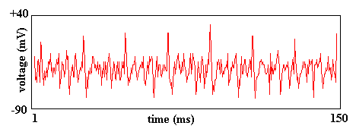
Communications between neurons
Signals: transmitter molecules, electric junction molecules – inter-cellular interactions
Integration of incoming signals followed by the generation of outgoing signal
Signalling actions: graded potentials or spikes

Slide 37
Referencing in neuron communications
The incoming spatio-temporal pattern of neural signals determines the outgoing signal
E.g., IF (integrate-and-fire) neurons

Slide 38
Nervous system and its environment
System: communications between neurons
Dense communications between neurons, relatively rare communications with other cells
Dense / rare communications boundary of the system / environment

Slide 39
Actions of the nervous system
Neurons send signals to muscles and other cells triggering communications in their local tissue systems
These are actions of the nervous system on it’s environment
Such actions may result in actions of the organism on it’s environment

Slide 40
Perceptions of the nervous system
As a result of nervous system actions and organism actions the environment acts upon the organism and its tissues, modifying the local communications between cells
These local communications are received by neurons and specialized receptor cells
The effects of these communications generate changed communications within the nervous system implying perceptions within the nervous system

Slide 41
Language of the nervous system
Spatio-temporal patterns of neural signals and conditional continuation distributions
Referencing rules and continuation rules

Slide 42
Meaningful neural communications
Communications that follow the rules of the grammar, reference other communications, and are referenced by further communications
Contribute to the reproduction and extension of the nervous system

Slide 43
Meaningless neural communications
False perceptions, false action commands
Lead to model errors, wrong behaviours – faulty communications leading to errors
E.g., epileptic seizure = short term self-reproducing and expanding communication system involving neurons as communication units that does not fit into the communication system of the nervous system

Slide 44
Subsystems of the nervous system
Constraints on communication - structures
Neural communications about some particular subset of actions and / or perceptions – constrained communications
E.g., motor system, visual system, olfactory system

Slide 45
Reproduction and expansion of the nervous system
Neurons which do not receive and send meaningful signals die
New communications referencing earlier ones and providing reference for further more inter-neuron communications

Slide 46
Identity violations
Faults: wrong inter-cellular communications – e.g. cancer, phantom pain
Errors: lack of continuation of communications – e.g. toxins blocking channels in neuromuscular junctions, asphyxiation – lungs cannot exchange CO2 for oxygen
Failure: neuro-degenerative disease, infection leading to death of the organism

Slide 47
Adaptation – Organism
Lack of food triggers the movement of C. Elegans worms:
There is an expectation of inter-cellular communications, which can happen only if there is enough nutrient in the body of the worm
Lack of food causes the lack of continuation of the above inter-cellular communications
This is monitored by the nervous system, which sends new communications to the muscle cells triggering the movement of the worm towards a place with possibly more bacterial food

Slide 48
Adaptation – Nervous system
New connections between neurons are formed and many other existing connections released during the development of the organism
E.g. lack of visual input may lead to the participation of normally vision brain areas in the processing of auditory information in young cats

Slide 49
Complexity of the nervous system
Amount of communications and neurons
Number of sub-systems
More complex information system allows more complex description of the organism / environment allowing more efficient maintenance and reproduction of the organism

Slide 50
Complexity of organisms
No nervous system / information subsystem → low complexity
Complex nervous system → high complexity

Slide 51
Summary – 1
Multi-cellular systems
Tissues
Organs
Functional ‘systems’

Slide 52
Summary – 2
Memory
Identity
Organism information subsystem: nervous system
The system of neurons
Subsystems of the nervous system
Complexity

Slide 53
Q&A – 1
Is it true that cells communicate with each other by generating lipid membranes ?
Is it true that referencing in a multi-cellular system means that each cell’s communication depends on its earlier communication signals and the communication signals of other cells ?
Is it true that the muscle cells form a tissue system, which is a subsystem of the organism ?
Is it true that the environment for the muscle tissue is the same as the environment for the whole organism ?

Slide 54
Q&A – 2
5. Is it true that the programmed cell death causes meaningless communications within a tissue ? What about this in the context of a cell system ?
6. Is it true that organs constitute subsystems of an organism ?
7. Is it true that physiological diseases can be seen as generation of meaningless communications within some local tissue ?

Slide 55
Q&A – 3
Is it true that the letters of the neural communication language in higher nervous systems are the spikes, while the words of the communications are spatio-temporal patterns of spikes ?
Is it true that the perceptions of the nervous system are about the environment of the organism ?
Is it true that nervous system describes the environment of the organism ?

Slide 56
Q&A – 4
11. Is it true that the nervous system has subsystems ?
12. Is it true that organisms without nervous system can have the same complexity as organisms with nervous system ?

