Slide 1
Evolution of Complex Systems
Lecture 6: Brain and mind
Peter Andras peter.andras.ncl@gmail.com
2022 Edition

Slide 2
Objectives
Subsystems of the nervous system
Brain structure
Sensory and motor subsystems
Information subsystem of the brain: memory and language
Language and mind
Identity violation and adaptation

Slide 3
Neurons
Specialized cells dealing with information about the organism
Special communications: neurotransmitters
Special communication actions: graded potentials, spikes

Slide 4
Nervous system
Information subsystem of the organism
Higher animals have nervous tissue as a tissue system (→ nervous system)

Slide 5
Subsystems of the nervous system
Sensory and motor subsystems
E.g., olfactory system, visual system, motor system

Slide 6
Organisation of nervous subsystems
Ganglions in insects, e.g., olfactory lobe, stomatogastric ganglion
Each ganglion contains neurons communicating about a specific topic, a part of the self description

Slide 7
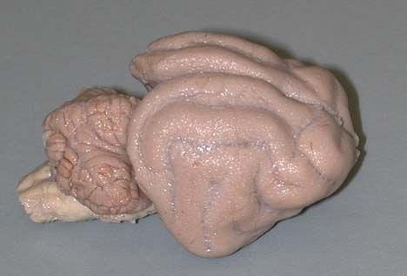
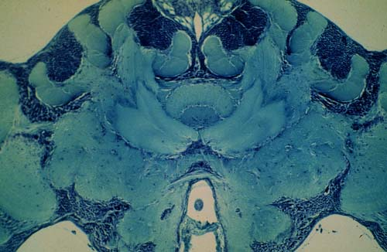
The brain
Collection of major ganglions with specialist integrating components (integrating ganglions)
E.g., insect brain, octopus brain, cat brain
(www.neurobiologie.fu-berlin.de/gruenewald)
(serendip.brynmawr.edu)

Slide 8
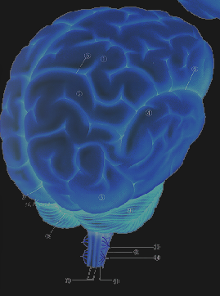
Large brains
Components:
Brain stem
Midbrain
Limbic system
Cortex

Slide 9
Sensory systems – 1
Components:
Sensory ganglion
Brainstem nuclei
Midbrain centres
Limbic centres
Cortical areas
E.g., auditory system: auditory ganglion, cochlear nucleus, superior olivary nucleus, inferior colliculus, medial geniculate body, lateral posterior nuclei, reticular nucleus, auditory cortex

Slide 10
Sensory systems – 2
Higher areas are dealing with more detailed information using more abstract descriptions
E.g., visual system: V1, V2 – oriented bars, continuous lines; V2, V4 – colour, shape; V3, V5 – motion, location

Slide 11
Motor system
Cortical motor area
Cerebellum
Lower brain centres
Motor nerve ganglions
More abstract

Slide 12
Association areas
Cortical areas not directly involved in sensory-motor processes
Large part of the cortex
E.g., human brain

Slide 13
Integration of neural subsystems
Association neural subsystems
Integrates information form other subsystems

Slide 14
Communications in neural subsystems
Specialized content, special references, special language of activity patterns
The same basic unit neurons communicate by neurotransmitters using spikes as communication actions
However, there are two major classes of neurons: excitatory and inhibitory neurons, and there are many kinds of neurons for each of these classes, with different gene expression profiles, different neurotransmitters and different behavioural patterns

Slide 15
System boundary of neural subsystems
Intense communication within the subsystem about the sensory perceptions or motor commands related to the specialist topic
Relatively low amount of communications with the outside of the subsystem

Slide 16
Meaningful and meaningless
Meaningful: interpretations that fit the specialist model
Meaningless: unsolvable interpretation problems, i.e., the received sensory information cannot be interpreted / understood within the limits / the language of the specialist subsystem → identity violation
E.g., hallucinations

Slide 17
Memory and the nervous system
Memory: recordings of earlier communications within the nervous system
E.g., memories of earlier neural communications representing perceptions and actions

Slide 18
Information subsystem of an information subsystem
Interactions between memories
Virtual planning of actions using memories, evaluation of new perception using memories
Memory processing → information subsystem of the nervous system

Slide 19
Long-term memory
Communications between memories → short-term planning (e.g. control of reflex behaviour)
Memories of communications between memories → long-term memory
Dreaming – communications between long-term memories

Slide 20
Memory and brain
Understanding / interpreting / modelling the perception and action generation by the nervous system
Short-term memory and long-term memory
Communications about the functioning of the brain
This is the role of the association areas organized as a system

Slide 21
‘Who am I ?’
The main question of the information subsystem of the brain: what neural communications are correct, which are part of the correct informational model → system identity
Deciding what is ‘I’ and what is not ‘I’
Communications about the proper interpretation of neural communications

Slide 22
Actions of the information subsystem
Identity definition, identity checking, identity enforcement
Communications questioning the correctness of interpretations generating questioning actions: intentional actions
E.g., intentional body movements

Slide 23
Perceptions of the information subsystem
Analysis of interpretations by neural subsystems in order to decide what perception interpretations are part of the proper self, which fit the identity of the system
E.g., conscious perceptions

Slide 24
Memory and language
Communications between long-term memories
Language: the language of communications about long-term memories – memories of communications between long-term memories

Slide 25
Language and reference
The language deals with the self identity, with what is intentional and what is not, and what is consciously perceived and what is not, what is part of the identity
These communications are based on a specialist neural communication language representing the communication signals of the identity system
In humans this is the identity defining language that we use to monologue about ourselves
Such communications refer to earlier ones and their root is the initial question of defining the ‘I’

Slide 26
The mind
The communication system about the conscious identity constitutes the mind – the core of the information subsystem of the brain
The mind’s language is the internal language used to communicate about long-term memories and identity. It is aimed to decide what is part of ‘I’ and what is not → personality

Slide 27
Good and bad
The system of communications about the identity of the ‘I’ adapts as the individual develops and experiences their environment
This adaptation is driven mainly by the interaction with individuals of the same species – the social environment
Communications about the ‘I’ drive patterns of behaviours and some patterns are perceived as correct / good while others as incorrect / bad (e.g. good / potentially effective and bad / most likely ineffective versions of courtship behaviour)
In humans this leads to the distinction between good and bad, which acts as anchor for the communications about the self → foundation of morality and ethics in a social context

Slide 28
The mind subsystem of the nervous system
Boundary: dense communications about the identity of the self, rare communications with other parts of the brain, i.e., getting the info that is analysed in many details
It is a subsystem of the nervous system like the sensory subsystems, but this deals with the information subsystem of the nervous system → identity subsystem

Slide 29
Language grammar
The grammar: conditional continuation distributions are the grammatical rules of human language in the case of humans

Slide 30
Meaningful communications
Communications about the identity that reference other such communications and are referenced by further communications
These communications fit with the identity of the system

Slide 31
Meaningless communications
Communications that do not fit the identity of the personality
These end up with contradictions, communications about which it is impossible to decide whether they are about a part of the identity or not → identity violations
E.g., self-analysis paradoxes

Slide 32
Happiness and euphoria
The identity self perception when limit expectations about the identity are confirmed, i.e., low probability conditional continuations are experienced about the identity
Euphoria: extreme happiness

Slide 33
Sadness and depression
The identity system runs into paradoxes repeatedly or into communications contrary to the expectations, i.e., zero probability continuation communications are experienced, which do not fit into the identity model
Identity violations (faults, errors) add up to system failure
Depression: extreme sadness

Slide 34
Suicide
Communications about the identity that lead to the destruction of the identity system by running regularly and frequently into paradoxes
The identity system is not maintained, which triggers corresponding actions of the nervous system and of the organism – complete system failure

Slide 35
Multiple-personality disorder
Possibly due to paradoxes the identity system divides into subsystems developing separately
Alternatively: possibly a replication of the identity system aimed to extend the identity system

Slide 36
Pharmacological interventions
By changing the environment of the organism’s neurons the neural communications change
Such changes may favour the generation of euphoria (drugs) or depression (lack of drugs in addicts) by facilitating the appropriate communications

Slide 37
Adaptation in the mind – 1
Conflicting conclusions about the identity of the self are resolved by identity revisions
Identity revision: elimination of the root of the paradoxical situation by imposing additional constraints on identity communications (prevention of the re-occurrence of the root)

Slide 38
Adaptation in the mind – 2
Identity revision:
Identity definition: ‘I am researcher, and I am not a technician’
Identity checking: ‘I will wear the blue shirt, and have a tie, that fits really with me being a manager’
Identity enforcement: ‘I have to sell the house, everybody in my circle lives in the posh part of the city – living here makes me look really ridiculous’

Slide 39
Subsystems of the mind
Communications about the self identity specialized in some aspects of the identity
E.g., professional identity, within-family identity (in humans)

Slide 40
Brain complexity
Brains without memory and information subsystem are less complex; i.e., those with little associative structures, e.g., jellyfish
Brains with memory and information subsystem are more complex; i.e., those with more associative structures, e.g., cat

Slide 41
Cortex complexity
The cortex is the most developed associative structure in vertebrates
More associative cortex → more complex brain / nervous system / organism
More complex identity → personality

Slide 42
Summary
Nervous system
Sensory and other sub-systems
The brain
Information subsystem of the nervous system: mind
Identity violation and adaptation
Complexity of brain and mind

Slide 43
Q&A – 1
Is it true that the nervous system of most animals has a visual subsystem ?
Is it true that centres of subsystems of insect nervous systems are organized in ganglions ?
Is it true that insects usually have large associative ganglions ?
Is it true that visual illusions are meaningful communications within the visual subsystem ?

Slide 44
Q&A – 2
5. Is it true that the key question of the identity subsystem is ‘Who am I’ ?
6. Is it true that the mind is an independent system from the brain ?
7. Is it true that self-analysis paradoxes lead to damages in the mind system ?
8. Is it true that the lack of reproduction of the identity system due to paradoxes may lead to triggering self-destruction ?
9. Is it true that brains with more associative structures characterise more complex organisms ?

