Slide 1
Analysis and understanding of complex neural systems
Peter Andras
School of Computing and Mathematics
Keele University
p.andras@keele.ac.uk

Slide 2
Overview
Brain area networks
Network analysis – issues and approaches
Networks of biological neurons
Modelling neural systems
2

Slide 3
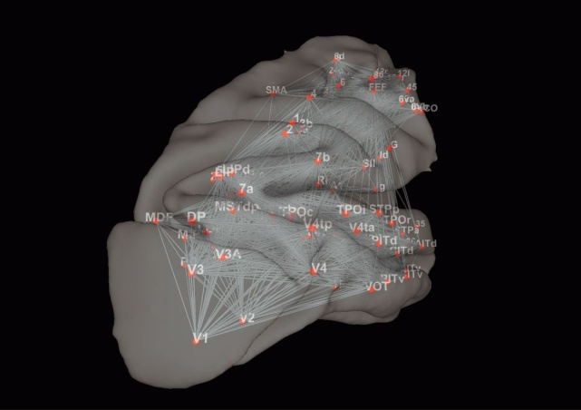
Brain area networks
CoCoMac database – connectivity of brain areas in cat and macaque (brain areas defined in histological sense)
Connectivity ~ estimate of the number / relative importance of connecting axons
E.g. V1 receives around 5% of its inputs from LGN

Slide 4
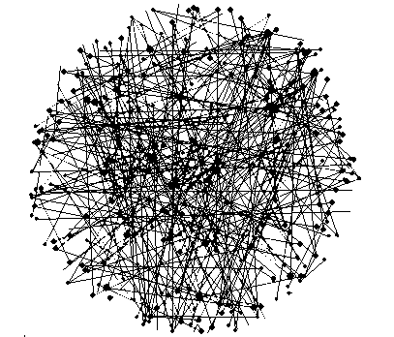
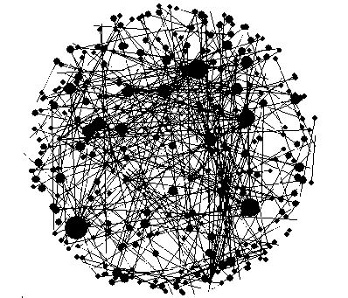
Erdos-Renyi vs Scale-free networks
Erdos-Renyi networks: uniform probability of links between any two nodes → exponential distribution of connectedness (P(k)=exp(-λ*k))– very few highly connected nodes
Scale-free networks: more connected nodes are more likely to be linked to other nodes → power law distribution of connectedness (P(k)=k^(-γ)) – some very highly connected nodes
4

Slide 5
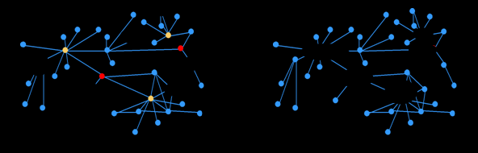
Implications of being scale-free
Scale-free networks are robust to random damage, but vulnerable to well-targeted damage
5

Slide 6
Are brain area networks scale-free ?
Networks: around 60 nodes with 600 – 800 connections – small networks
Measurements of such small size networks may be misleading

Slide 7
Comparison of networks
Method:
measure key parameters of these networks (average clustering coefficient and average connectivity)
generate a set of scale-free networks and a set of exponential networks with the same parameters
test statistically whether the brain networks behave in the same way or not in terms of damage measures as the random sample of scale-free or exponential networks – test both random and targeted damage

Slide 8
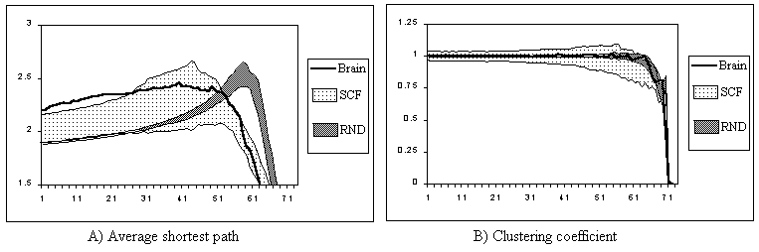
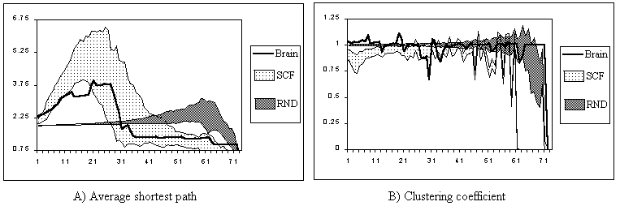
Determination of scale-free-ness
The analysis shows that the brain networks are more similar to scale-free networks than to exponential networks
However, in terms of the evolution of the average clustering coefficient under targeted node elimination the brain networks are more similar to exponential networks
Macaque brain network with random and targeted node elimination
Kaiser M, Martin R, Andras P, Young MP (2007). Simulation of structural robustness of cortical networks. European Journal of Neuroscience, 25 (10): 3185-3192.

Slide 9
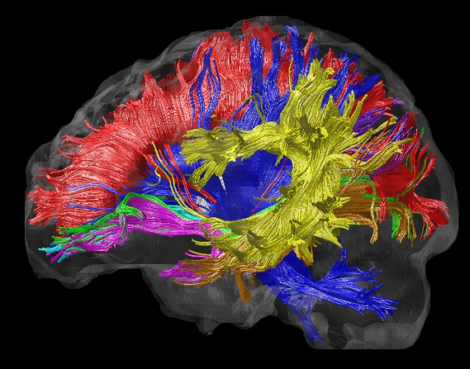
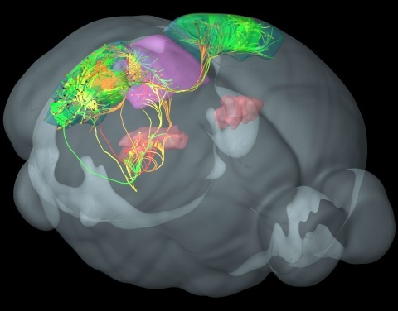
Recent works
Area connectivity from DTI using MRI data
Viral tracing data
From: neuroimaging.tau.ac.il
From: www.painresearchforum.org

Slide 10
Network analysis issues
Data about real world large scale networks are not easily accessible – expensive, private, noisy
Network analysis methods are often tried and tested on artificial surrogate data
The validity and meaningfulness of these methods may be questionable

Slide 11
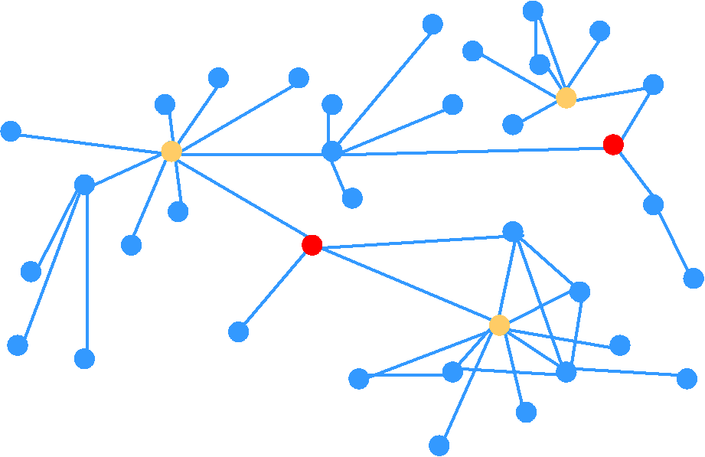
Example: searching for new antibiotic targets – 1
Node importance – contribution to structural network integrity
Key assumption: structural and functional integrity correlates well
Centrality measures:
Connectedness – Hubs
Betweenness – Bottlenecks
Aim: find pairs of joint targets
B. subtilis
Idowu, O, Andras, P (2005). Identification of functionally essential proteins from protein interaction networks. In: Proceedings of CIMED 2005, pp.330-333.

Slide 12
Example: searching for new antibiotic targets – 2
12 predictions of pairs of potential joint targets
2 years of experiments with mutant bacteria – 1 postdoc + lab costs
Result: some predicted target pairs lowered the growth rate of the bacteria, but none did it is sufficiently to qualify as an effective antimicrobial combination

Slide 13
How to improve the validity of network analysis methods ?
Get large volume of valid, cheap, and reliable data
Large-scale software:
System of interactions between objects / classes
Dynamic analysis provides data about what actually happens in the software
Repeatable, easy to vary experiments generating large volumes of reliable data quickly and cheaply

Slide 14

Example: analysing Google Chrome
Many developers
Development over extensive time period
Integration of many components, patches, bug fixes
6 million lines of code

Slide 15
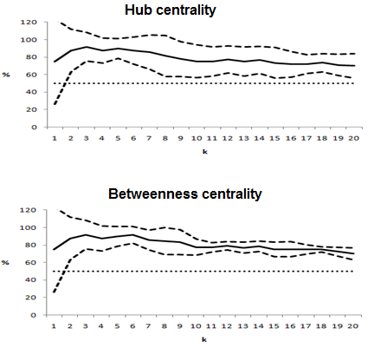
Google Chrome – functionally important method calls
A method call is functionally important if it’s correct execution is critical for the positive user experience in the context of an execution scenario (e.g. delivery of a software behavioural feature)
Network analysis based prediction methods using hub and between-ness centrality based ranking
Pakhira, A, Andras, P (2012). Using network analysis metrics to discover functionally important methods in large-scale software systems. Proceedings of the 3rd International Workshop on Emerging Trends in Software Metrics (WETSoM 2012), pp.70-76.
Pakhira, A , Andras, P (2012). Leveraging the cloud for large-scale software testing – A case study: Google Chrome on Amazon. In: Tilley, S & Parveen, T (eds.) Software Testing in the Cloud, Information Science Reference – IGI Global, Hershey, PA, pp.252-279.

Slide 16
Summary – 1
Increasing volume of improving quality data is available about brain-scale connectivity
Meaningful network analysis requires validated analysis methods, which requires large volume of accessible and good quality network data
Dynamic analysis of large scale software can be used to generate this required data

Slide 17
Biological neural networks
How do biological neural networks deliver their emergent functionality ?
Do neurons change their functional identity ?
Which neural system can provide data with sufficient detail and quality ?

Slide 18
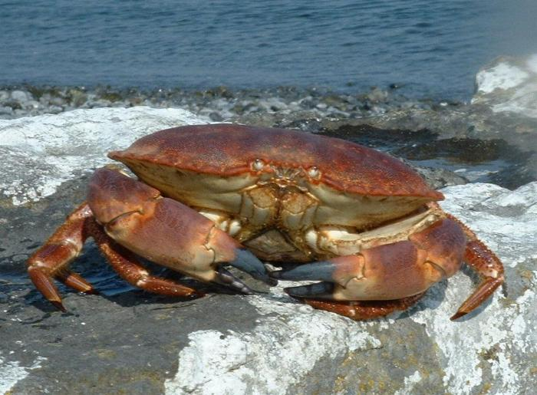
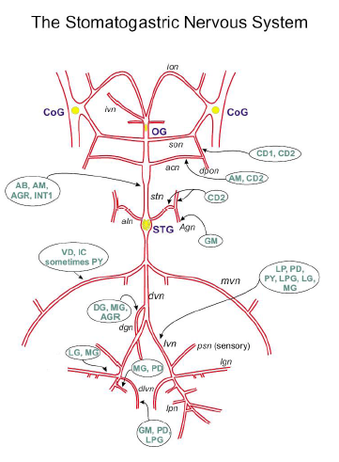
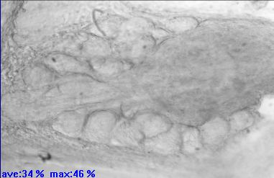
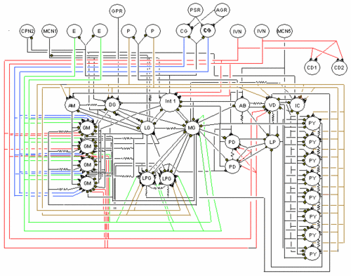
Crab stomatogastric ganglion
26 neurons arranged in a relatively flat sheet
Relatively isolated (one input nerve from higher ganglia)
Complex behaviour – central pattern generators (CPG )
Ideal model system for studying neural activity patterns

Slide 19
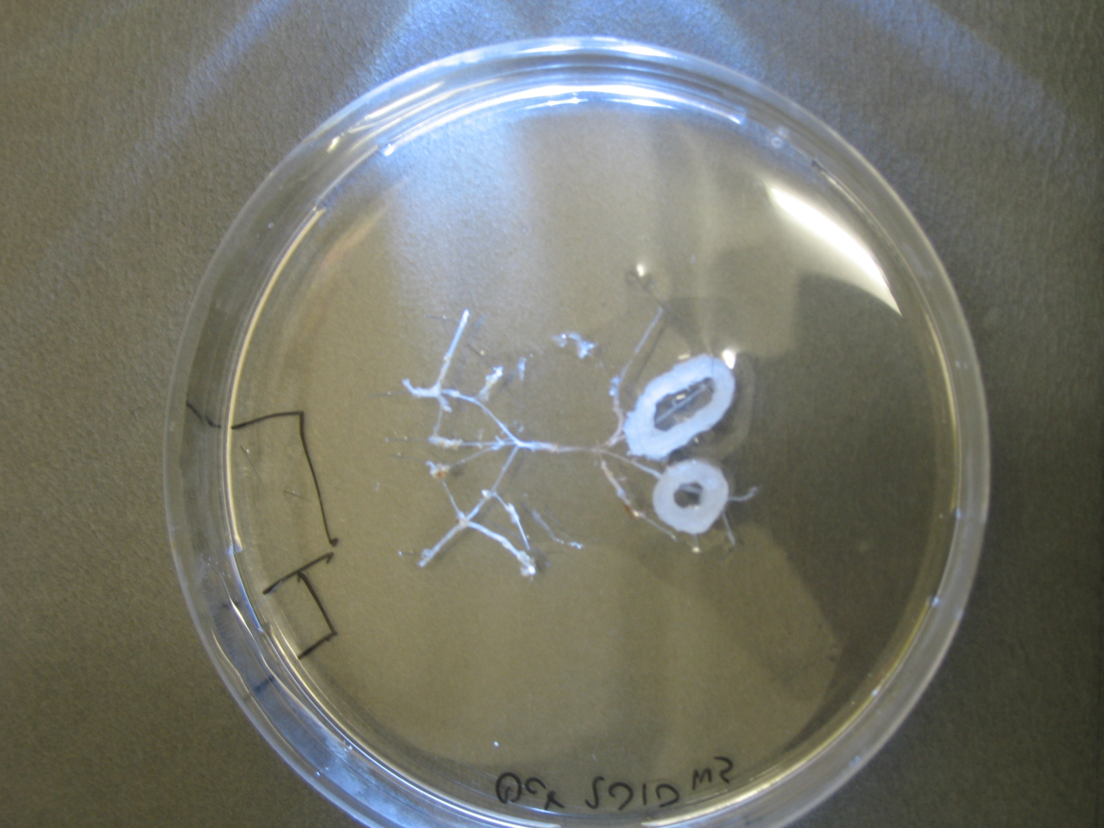
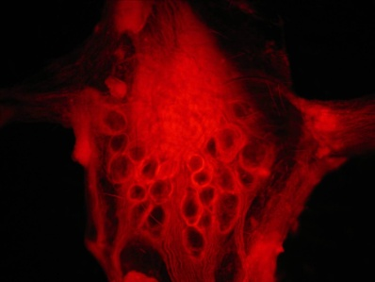
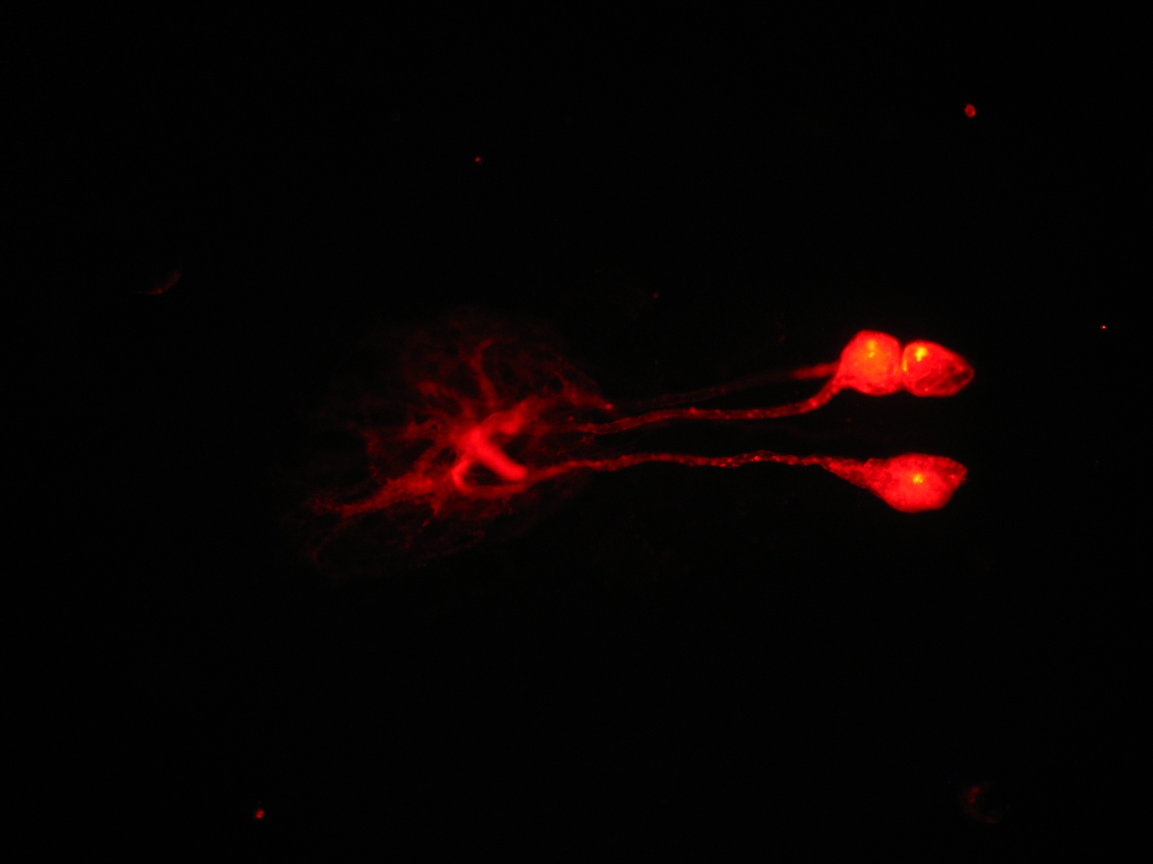
VSD imaging of the crab STG
Di-4-ANEPPS dye (20µl stock solution in 1 ml saline; stock: 5mg dye + 1ml DMSO/Pluronic acid)
Vaseline well around the ganglion
Bathing in dyed saline for 30-40 minutes
Washing with dye-free saline for 30 minutes
Works for crab and lobster as well
Stein, W, Städele, C, Andras, P (2011). Single-sweep voltage sensitive dye imaging of interacting identified neurons. Journal of Neuroscience Methods, 194:224-234
Stein, W, Städele, C, Andras, P (2011). Optical imaging of neurons in the crab stomatogastric ganglion with voltage-sensitive dyes. Journal of Visualized Experiments, doi: 10.3791/2567.

Slide 20
Identification of STG neurons
Städele, C, Andras, P, Stein, W (2012). Simultaneous measurement of membrane potential changes in multiple pattern generating neurons using voltage sensitive dye imaging. Journal of Neuroscience Methods, 203: 78-88

Slide 21
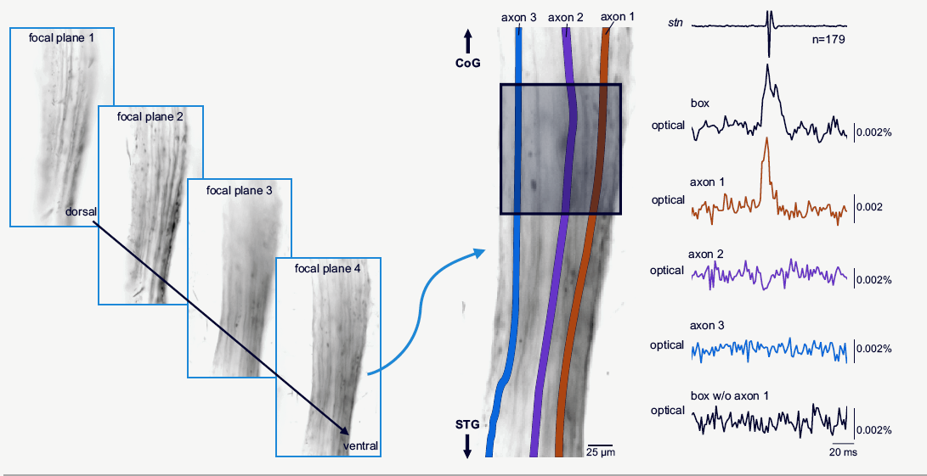
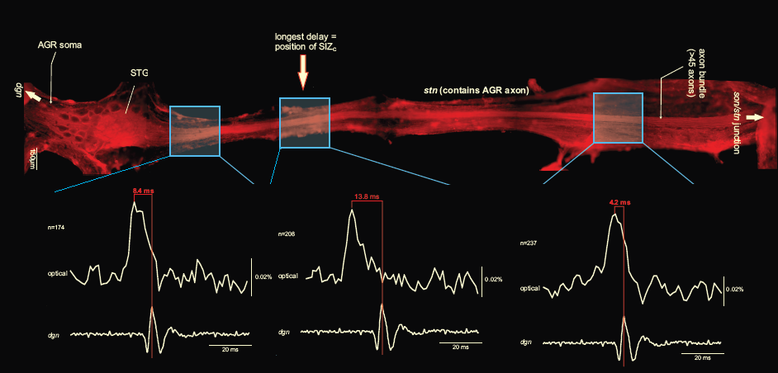
Axon imaging

Slide 22
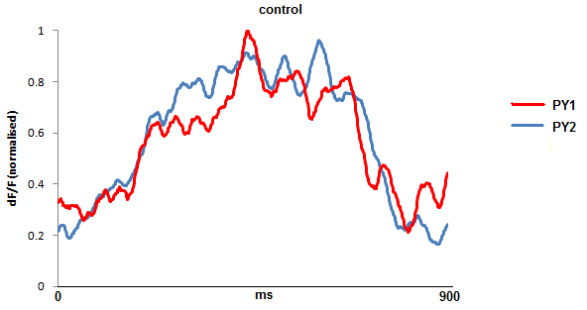
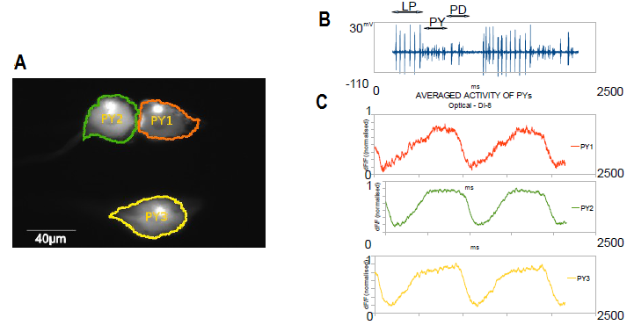
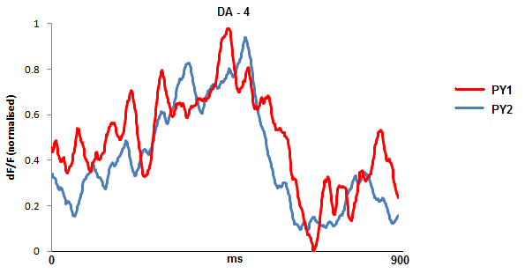
PY neurons under the effect of dopamine

Slide 23
Quantification of the effects of dopamine
Depolarized activity plateu
Feature points:
minimal slope
maximal slope
beginning of top zero slope
end of top zero slope
Trace features:
length of depolarized activity plateu
length of hyperpolarised inhibition period
Joint activity features:
length of temporal distance between matching feature points
Hyperpolarised inhibition period
Delay between matching feature points

Slide 24
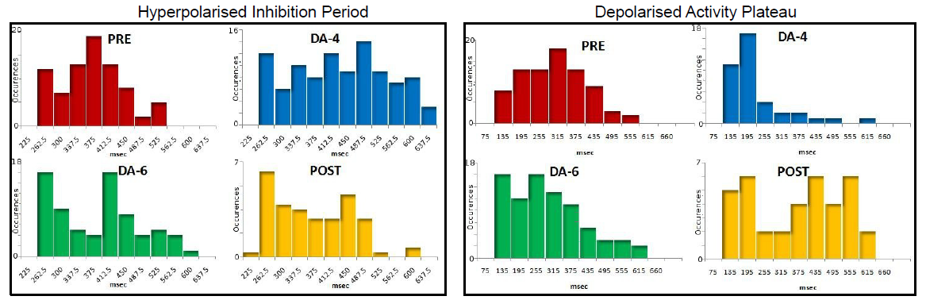
Dopamine impact on PY neurons
The hyperpolarised inhibition period gets longer under the impact of dopamine
The depolarised activity plateau gets shorter under the impact of dopamine

Slide 25
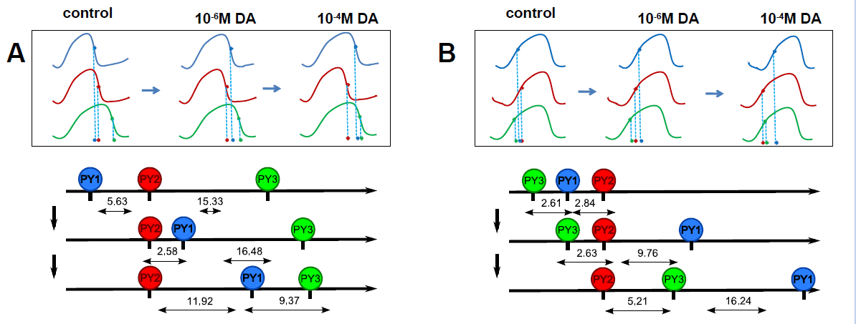
Dopamine impact on joint activity of PY neurons
The dopamine has differential effect on different PY neurons, shifting their feature points differently through the modulation of their activity → De-synchronisation of PY neurons

Slide 26
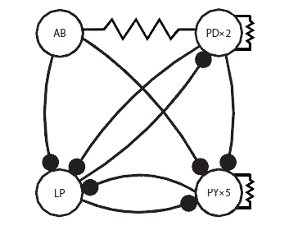
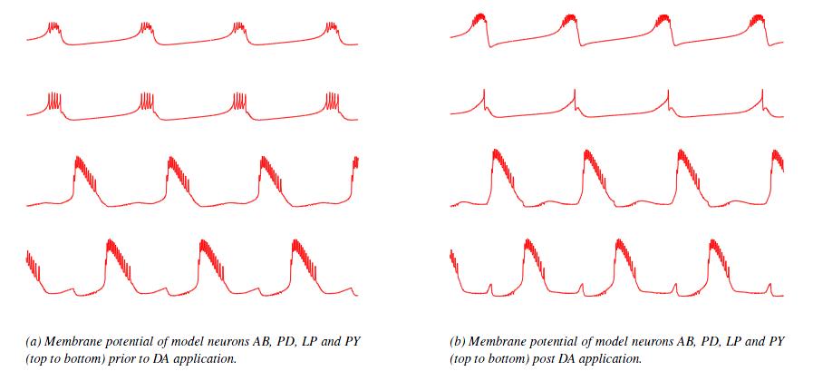
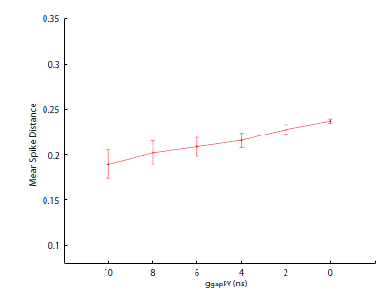
Modelling the dopamine impact on the crab STG

Slide 27
Conductance variability
The conductance of ionic currents is variable across the same kind of neurons within a single animal and across animals
Ratios of certain ionic current conductances seem to be stable (e.g. gH and gA relative to gK)
Neuromodulators, like DA, can change protein expression in short- and long-term as well, potentially shifting the conductance combination state of affected neurons

Slide 28
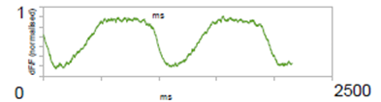
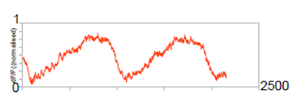
PY neuron roles
Early- and late-PY or PYs along a scale from early to late
Relative temporal order or distance of activity
Can PY neurons change their roles in response to neuromodulation ?

Slide 29
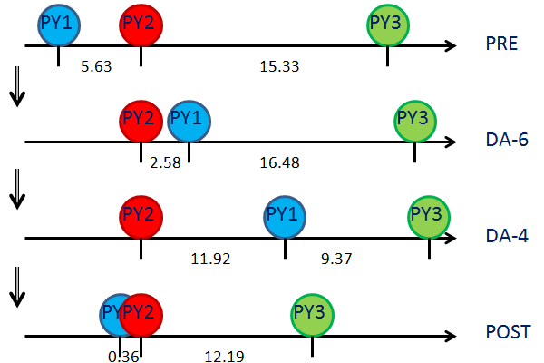
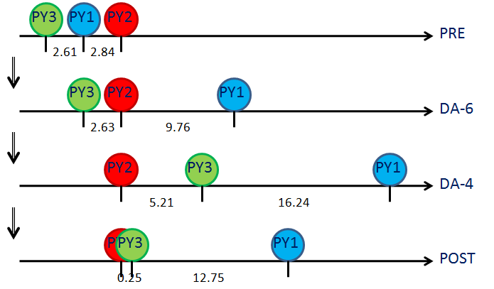
PY neurons following re-synchronisation
The relative temporal ordering and/or time distance of PY neuron activities changes

Slide 30
Differences of PD neurons
2 PD neurons in the crab STG – part of the AB/PD pacemaker
There is a temporal delay between the spikes of the two PDs
Does this delay have a functional significance, is it always the same PD which leads, do they change their roles ?

Slide 31
Modelling differences of PD neurons
Different gK and gCaS conductance values explain observed delayed joint PD activity patterns

Slide 32
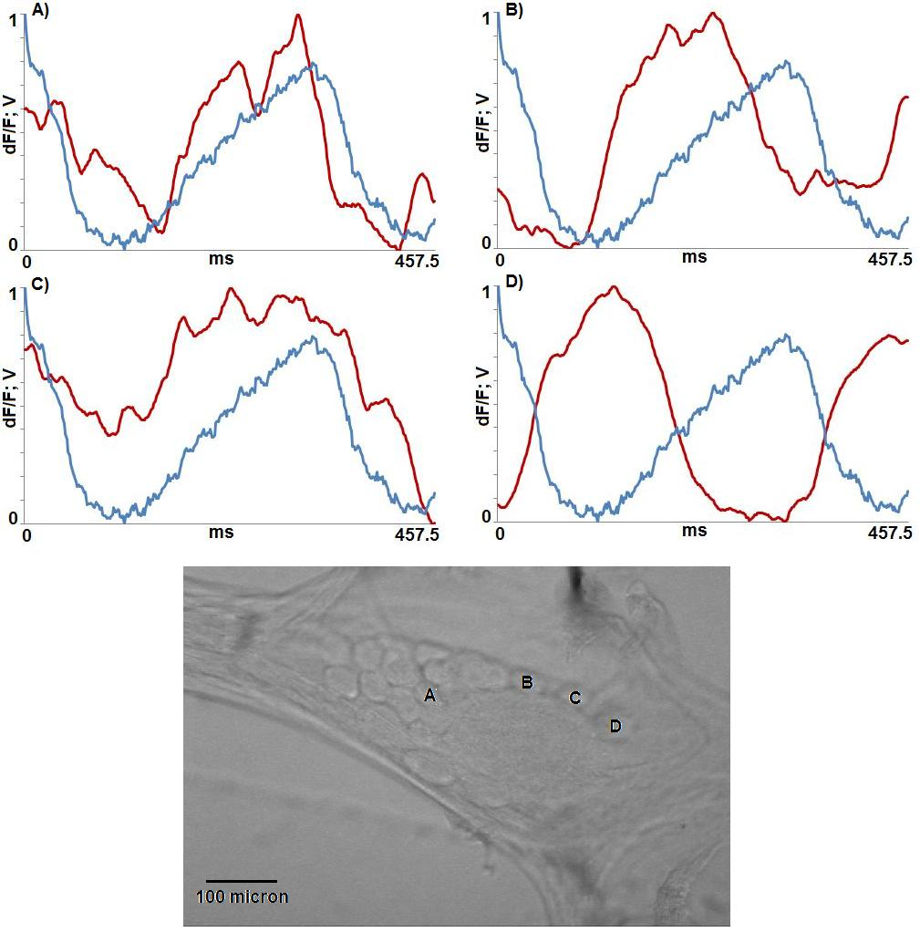

Related work – Dye design
Aim: to design novel voltage-sensitive dyes with better response than current ones to improve signal/noise ratio and data quality
Bodipy molecule based dyes – e.g. JULBD
Bai, D, Benniston, AC, Clift, S, Baisch, U, Steyn, J, Everitt, N, Andras, P (2014). Low molecular weight Neutral Boron Dipyrromethene (Bodipy) dyads for fluorescence-based neural imaging. Journal of Molecular Structure, 1065-1066: 10-15

Slide 33
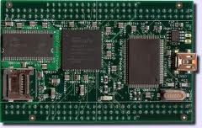
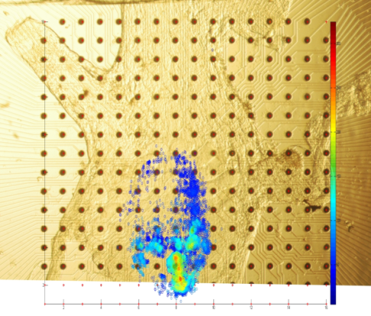
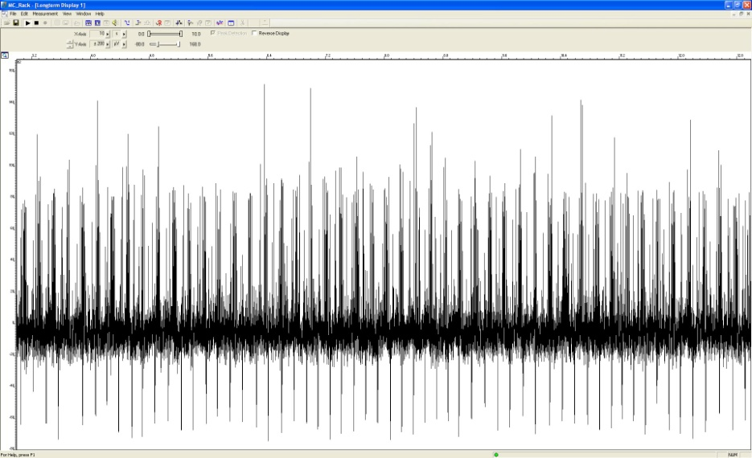
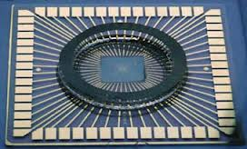
Related work – Neural system functionality restoration
Optogenetic silencing of selected neuron(s) – e.g. PD-s, LP
FPGA simulated neurons connect to the STG through an MEA to replace the activity of the inactivated neuron(s)
Aim: to restore the normal functional behaviour of the STG
Potential for a novel approach to neurochip implants

Slide 34
Summary – 2
The crab STG is a great model neural system for the study of emergence of system level functionality in biological neural networks
VSD imaging can provide detailed data to study
The functional stability/variability of neurons
The impact of neuromodulation on neuronal and network functionality
Computational modelling of the STG can explain a range of observed feature and also can guide the experimental investigations

Slide 35
Acknowledgements
Network analysis:
Marcus Kaiser, Olusola Idowu, Malcolm P Young, Anjan Pakhira
VSD imaging
Wolfgang Stein, Carola Staedele, Jannetta Steyn
Computational modelling
Thomas Alderson, Jannetta Steyn
Other STG related work
Andrew Benniston, Jun (Ryan) Luo, Jannetta Steyn
35

Slide 36
Thank you!
36

