Slide 1
Computational neuroscience
Peter Andras
School of Computing and Mathematics, Keele University

Slide 2
Overview
The brain
Neurons and information
Computational models
Mathematical and computational analysis
Back to biology

Slide 3
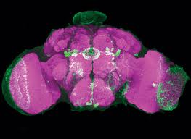
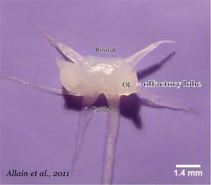
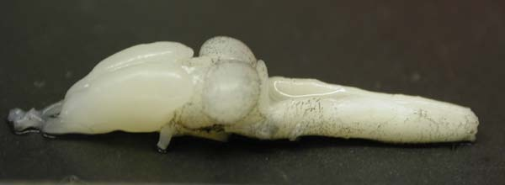
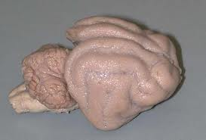
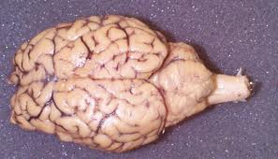
Brain function
The nervous system controls the behaviour of animals
The brain is a collection of high level specialised neural centres (ganglia)

Slide 4
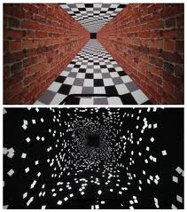


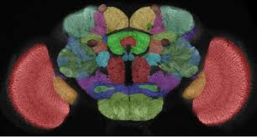
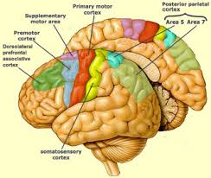
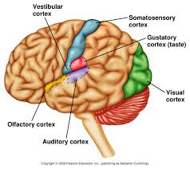
Brain function
Sensory brain: interpreting visual, auditory, somato-sensory, olfactory, etc information
Motor brain: high level control of muscles – large and fine scale control
Association brain: linking sensory and motor function, managing memories, making general sense of the world, driving communications

Slide 5

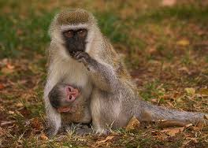
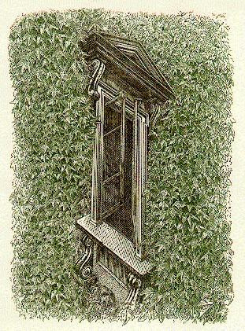
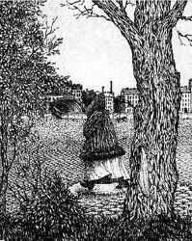
Cognitive brain
Understanding the world
Perception
Action
Decision making
Memories
Learning
Black box models

Slide 6

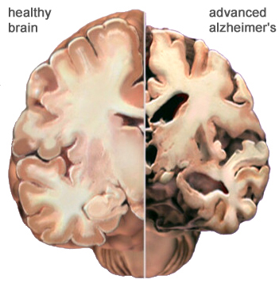
Brain disease
Parkinson’s Disease
Alzheimer’s Disease
Creutzfeldt – Jakob Disease (mad cow disease)

Slide 7
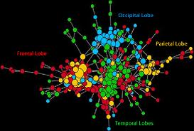
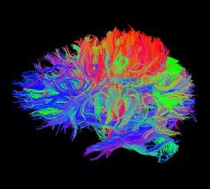
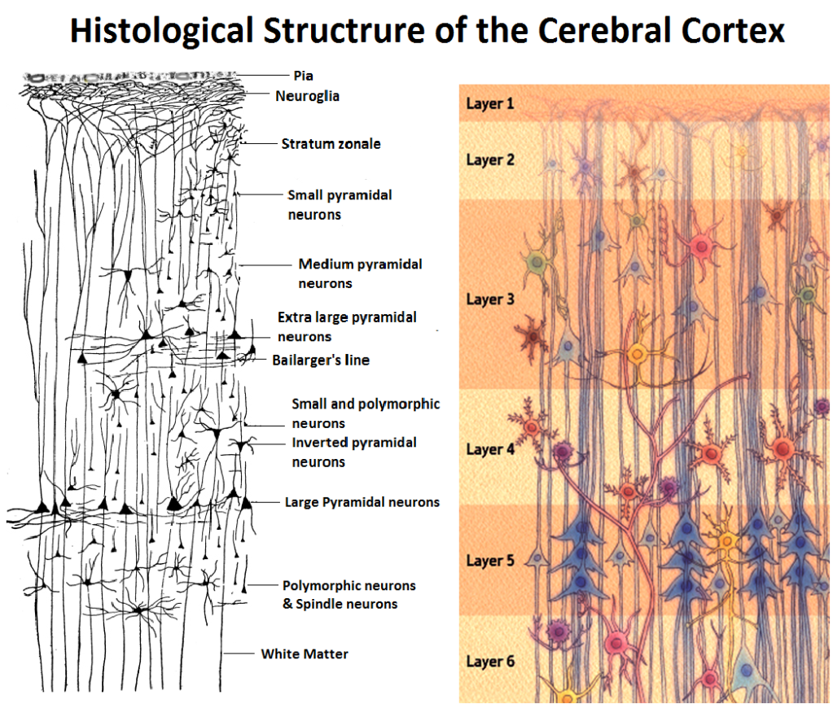
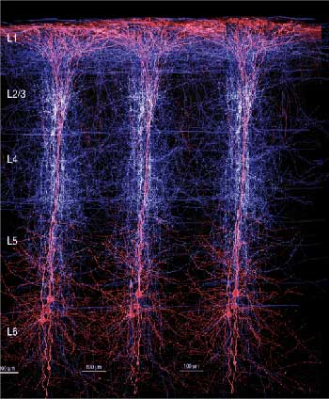
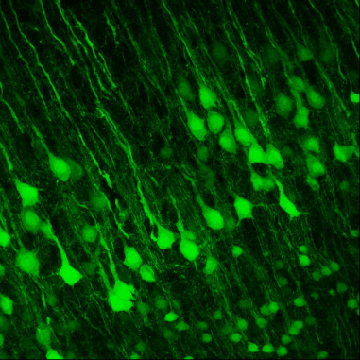
Brain structure
Large-scale connectivity – networks of brain modules
Layers of neurons

Slide 8
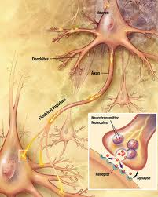
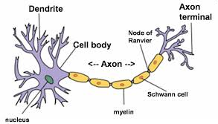
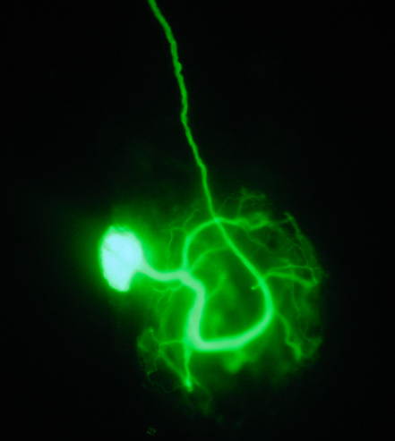
Neurons
Neurons are the building blocks of the nervous system
Synapses mediate communication between neurons
Synapses may form, get strengthened or weakened, or may disappear

Slide 9
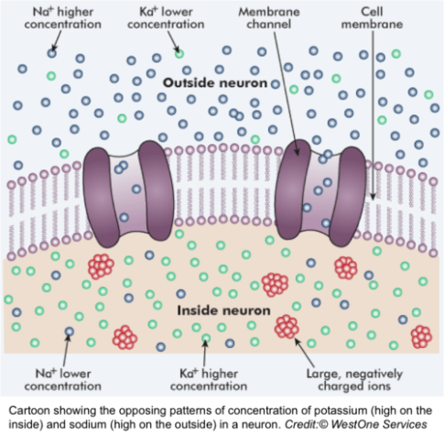
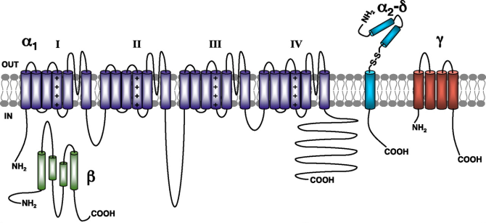
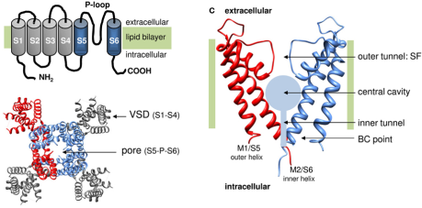
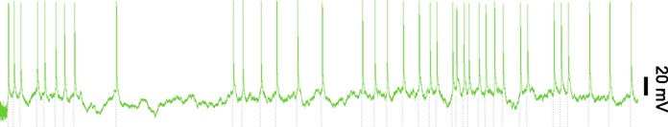
Neural activity
Neural cell membrane differential permeability for ions – Na+, K+, Cl-, Ca++
Ionic imbalance leads to steady state potential difference: ~-70 mV the inside is more negative than the outside
Neurotransmitters trigger the opening of ionic channels, also voltage-dependent channels, electric junctions (fully or partly bi-directional)
The membrane potential changes and this propagates along the membrane → dendritic signals, action potentials (spikes) in the axons
Spiking activity can be triggered by several mechanisms – e.g. excitatory input, rebound from inhibition

Slide 10
Neurons and information
Information may be encoded in the rate of spiking – e.g. sensory neurons, motor neurons innervating muscles
Information may be encoded in the temporal pattern of spikes – e.g. some projection neurons in the cortex
Information may be represented by spatio-temporal patterns of activity of many neurons – e.g. olfactory bulb, hippocampus – short term memory formation

Slide 11
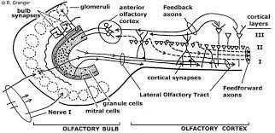
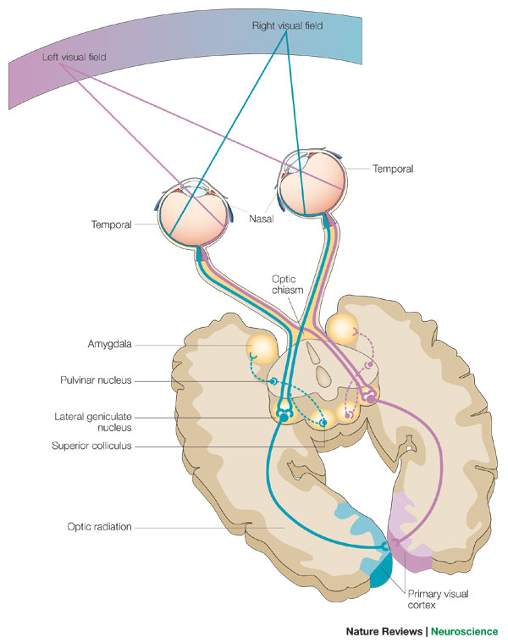
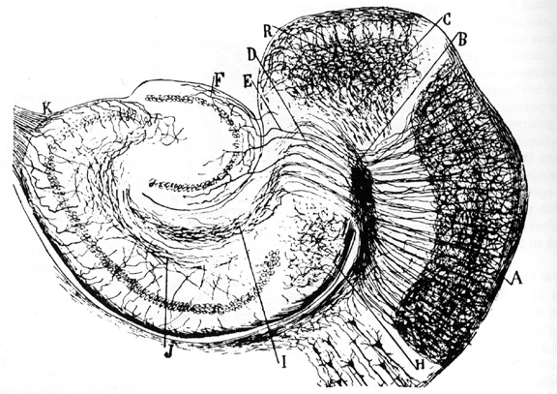
Neural circuits and networks
Neurons are organised in functional blocks
A neuron may belong to multiple functional blocks
Hierarchical combination of functional blocks

Slide 12
Neuromodulation
E.g. Dopamine, Serotonin, Noradrenalin, Oxytocin
Generally neuromodulators alter directly or indirectly the functioning of ion channels modulating the behaviour of neurons
Neuromodulators may also have long-term effects by influencing the transcription of the DNA
Neuromodulators determine the active parts of anatomical networks → many functional networks may be supported by the same anatomical network under different neuromodulation

Slide 13
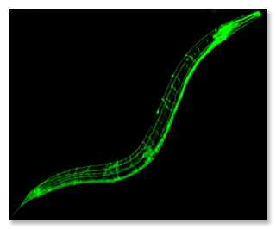
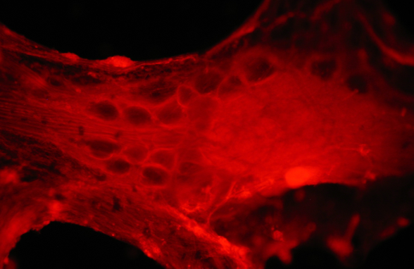
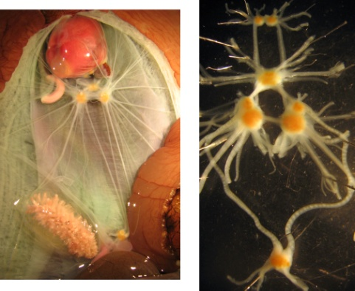
Model animal systems
C. Elegans – network organisation, development, sensory – motor coordination
Crab / lobster stomatogastric ganglion – neuromodulation, motor control – central pattern generator, autonomous functional restoration
Aplysia – memory and learning
Drosophila – complex behaviour, development

Slide 14
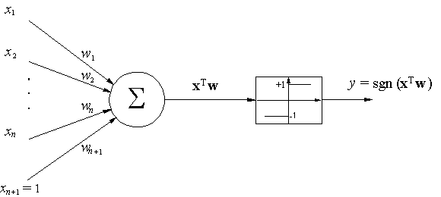
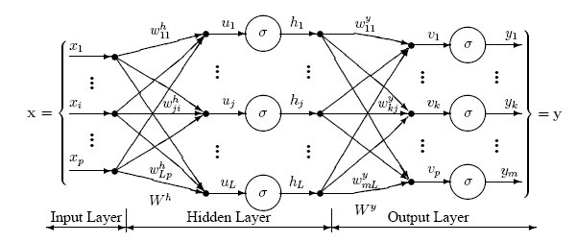
Computational models
Simple models – perceptron: 0 / 1 – active / inactive
Networked models – nonlinear, multi-layer perceptrons
Classification theory
Nonlinear approximation theory

Slide 15
Computational models
More realistic models based on ionic current conductances and modelling of ionic currents
Hodgkin – Huxley (HH) model

Slide 16
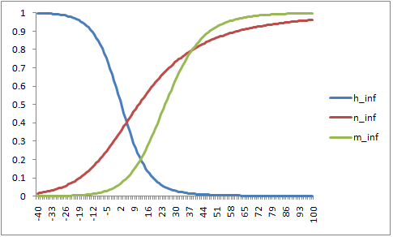
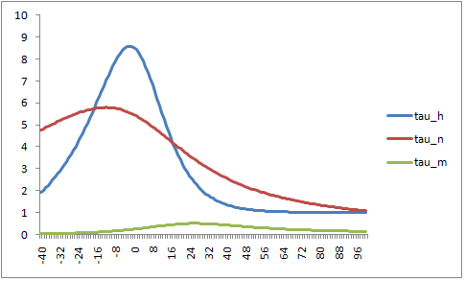
Computational models
Original Hodgkin – Huxley model

Slide 17
Computational models
Simplified models
Hindmarsh – Rose
FitzHugh – Nagumo
Morris – Lecar

Slide 18
Model analysis
Variable – corresponding nullclines –
Intersections of nullclines → nodes, saddles, focuses, saddle-nodes
Stable equilibrium points imply convergence to a steady state
Limit cycles – periodic trajectories
Activity along a limit cycle may correspond to sub-threshold oscillations or spiking behaviour
Phase plane analysis
Unstable Focus
nullcline
Stable node
nullcline
Saddle

Slide 19
Model analysis
Depending on external input ( ) the nullclines shift and the system that converged previously to a stable node or focus experiences a change moving it onto a limit cycle trajectory → silent neuron becomes a spiking neurons
Alternatively the system may be on small scale limit cycle and switches to a larger size limit cycle → neuron with sub-threshold activity starts spiking
Reverse transition: the spiking stops
Stable node
Saddle-node
Saddle

Slide 20
Model analysis
Bifurcation analysis – how is the qualitative behaviour of the system changing as the parameters change (e.g. external input current)
Two heteroclinic orbits
One periodic homoclinic orbit

Slide 21
Numerical analysis
Combined slow and fast dynamics – requires adaptive integration step choice
Sensitivity to numerical precision of calculations
Numerical problems grow when simulated neurons get coupled into simulated neural circuits

Slide 22
Numerical analysis
Many parameter combinations correspond to the same behaviour in the modelled neuron
Exhaustive search of the parameter space – problem many parameters imply high dimensional parameter space, exponential growth of required samples
Experimental data shows correlations between parameters – use these to reduce the dimensionality and size of the parameter space
Different parameter combinations may produce the same basic behaviour but do not produce realistic behaviour in other circumstances (e.g. exposure to neurotoxins or neuromodulators, integration into a model neural circuit)

Slide 23
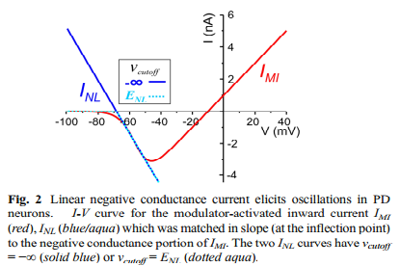

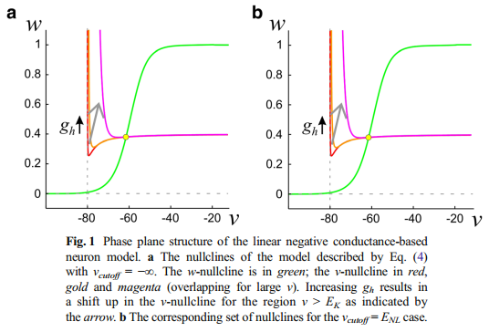
Example 1
Is nonlinearity in inward current required for spiking model neurons? (Bose, A Golowasch, J, Guan, Y, Nadim, F (2014) J Comput Neurosci, 37:229-242)

Slide 24
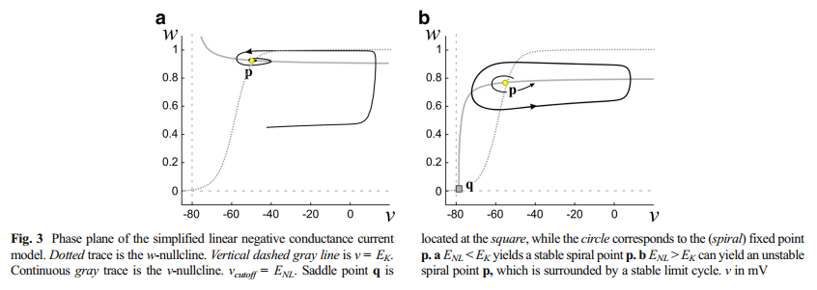
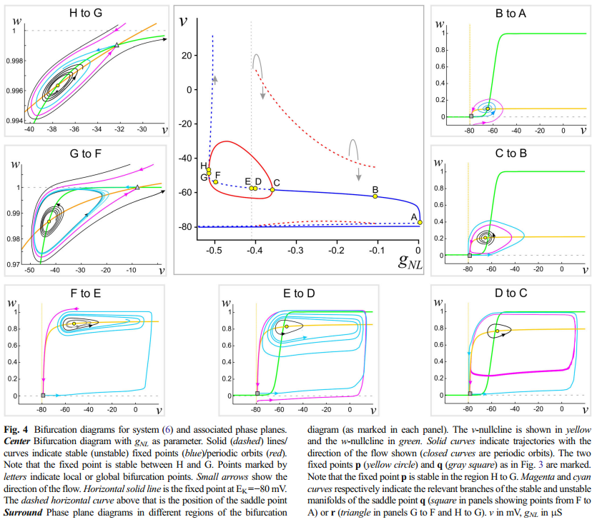
Example 1
Is nonlinearity in inward current required for spiking model neurons? (Bose, A , Golowasch, J, Guan, Y, Nadim, F (2014) J Comput Neurosci, 37:229-242)

Slide 25

Central pattern generators
Motor control
Movements of muscles are composed from rhythmic movements
Rhythmic movements are generated by neural circuits called central pattern generators
E.g. respiration, mastication, swallowing

Slide 26
Central pattern generators
Model:
Pacemaker neuron: autonomous rhythm generator
Reciprocally inhibiting neurons – half centre oscillator
Half-centre oscillator
Escape: the inhibited neuron’s behaviour changes and escapes from inhibition
Release: the inhibiting neuron’s behaviour changes and the other neuron gets released from the inhibition

Slide 27
Example 2
Analysis of CPGs with half-centre oscillators (Daun, S. Rubin, JE, Rybak, IA (2009), J Comput Neurosci, 27: 3-26)
Escape:
Release:

Slide 28
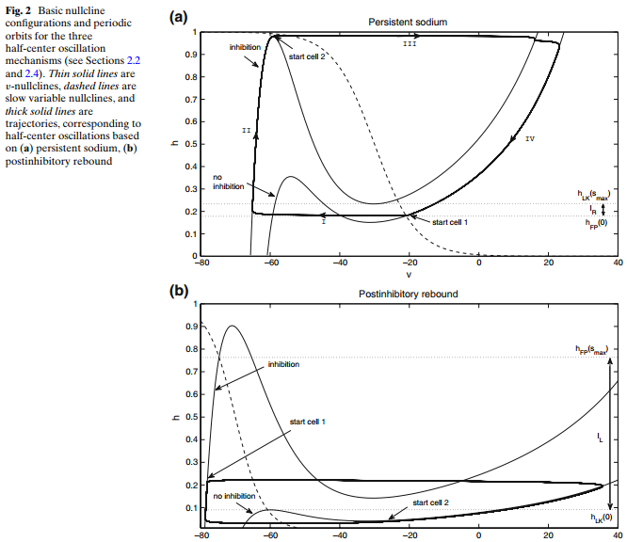
Example 2
Analysis of CPGs with half-centre oscillators (Daun, S. Rubin, JE, Rybak, IA (2009), J Comput Neurosci, 27: 3-26)
Escape
Release

Slide 29
Overlapping neural circuits
There is indirect evidence that neurons belong to multiple functional circuits in many parts of the nervous systems
E.g. place cells, grid cells, neurons in the primary visual cortex, swimming neurons in marine snails
What are the mechanisms of such neuronal behaviour ?

Slide 30
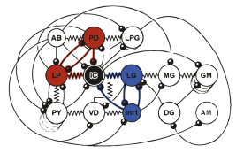
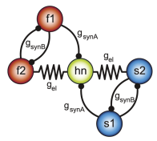
Example 3
Modelling and analysis of functional switching of neurons between rhythm generating circuits (Gutierrez, GJ, O’Leary, T, Marder, E (2013), Neuron, 77: 845-858.)
Model network with a hub neuron that may belong functionally to the two half-centre oscillator sub-networks (red and blue / fast and slow half-centre oscillators)
Crustacean STG with pyloric and gastric rhythm networks and the IC neuron at the intersection of these networks

Slide 31
Example 3
Modelling and analysis of functional switching of neurons between rhythm generating circuits (Gutierrez, GJ, O’Leary, T, Marder, E (2013), Neuron, 77: 845-858.)
Fast neurons
Slow neurons
Hub neuron

Slide 32
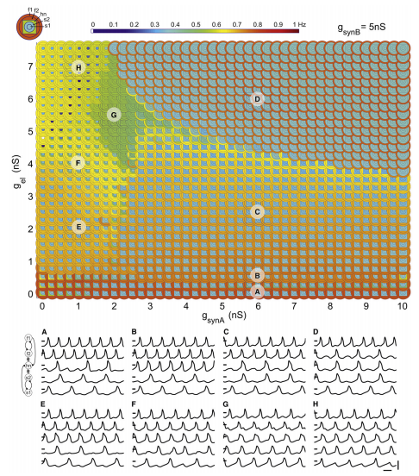
Example 3
Modelling and analysis of functional switching of neurons between rhythm generating circuits (Gutierrez, GJ, O’Leary, T, Marder, E (2013), Neuron, 77: 845-858.)

Slide 33
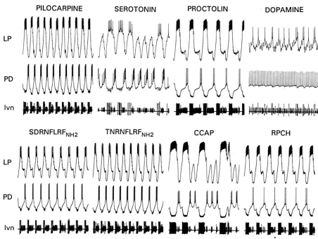
Modelling neuromodulation
It has been shown that neuromodulators can have a global impact on a network that is different from the sum of their impact on individual sepate neurons (e.g. Hooper and Marder, 1987, J Neurosci, 7: 2097-2112)

Slide 34
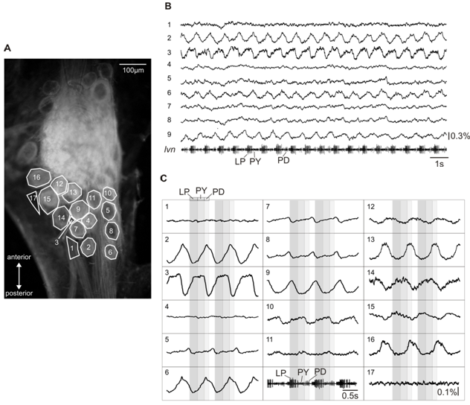
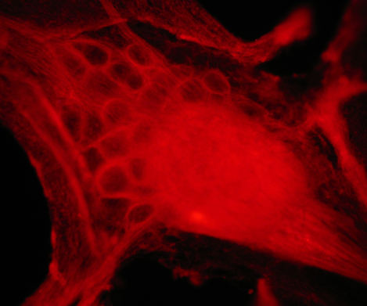
Modelling neuromodulation
Inclusion of modulator induced ionic currents into neuron models
Difficult to assess network effect
New data: simultaneous VSD recording of many identified neurons exposed to neuromodulation

Slide 35
Variability and robustness
Many parameter settings deliver the same model neuron behaviour
Parameter correlations are determined experimentally
Relatively small changes of parameters by neuromodulators may induce significant behavioural changes in individual neurons or the network of neurons

Slide 36
Variability and robustness
Investigation of the role of parameter variability in reproducing realistic network behaviour
Reproduction of the impact of neuromodulators and the analysis of changing roles of identified neurons in the context of the network

Slide 37
Phase locking
Synchronisation of weakly coupled oscillators
Oscillator = dynamical system moving along a limit cycle attractor
Coupling = synaptic and electrical connections
Generally: phase locking – can be the same or opposite phase or other phase relationship
Neuromodulation of phase locking

Slide 38
Leading to biological hypotheses
Predictions about
the roles and nature of ionic currents in neurons
the joint roles of neurons in the context of neural circuits
the mechanisms underlying the individual and joint roles of neurons
possible interpretations of experimental data

Slide 39
Leading to biological hypotheses
Examples:
multiple parameter values lead to similar neural behaviour → experimental testing led to the realisation of correlations between parameters
computational models of grid cells suggested a universal kind of position encoding by grid cells in the entorhinal cortex, which recently has been checked and rejected
computational models of neurons predicted behaviours of networks that were not confirmed experimentally → highlighting the role of neuromodulators and directing experimental investigations toward the study of impact of neuromodulators on network level behaviour

Slide 40
Leading to biological hypotheses
Often the predictions based on computational models are wrong, i.e. not confirmed or supported by the biological data
However such wrong predictions underline the conceptual errors in the biological and functional understanding of neural systems and direct the experimental work in directions that can provide elucidating answers and ultimately corrections of the previous wrong assumptions
Some predictions based on mathematical and computational analysis of course turn out to be correct

Slide 41
conclusions
Biological neural systems are very complex and difficult to understand
Computational modelling and mathematical analysis of models of neurons and neural circuits helps the understanding of how biological neural systems work
Bio-realistic modelling of neurons using conductance-based models are useful in particular both in terms of readiness for mathematical and computational analysis and in terms of biological relevance and ease of biological interpretation
Often predictions based on computational models and analysis are wrong, but even in such cases they contribute very much for the direction of experimental research towards questions that lead to much improved understanding of biological neural systems

Slide 42
Acknowledgements
Newcastle University
Jannetta Steyn (PhD student)
Thomas Alderson (MSc student)
Illinois State University
Dr Wolfgang Stein (PI)
Carola Staedele (PhD student)

