Slide 1
Neural Network Approximation of High-dimensional Functions
Peter Andras
School of Computing and Mathematics
Keele University
p.andras@keele.ac.uk

Slide 2
Overview
High-dimensional functions and low-dimensional manifolds
Manifold mapping
Function approximation over low-dimensional projections
Performance evaluation
Conclusions

Slide 3
High-dimensional functions
Data sample:
Approximate on the basis of the data sample

Slide 4
Neural network approximation
Neural network = linear combination of a set of parametric nonlinear basis functions

Slide 5
Problems
The size of the uniform sample with the same spatial resolution grows exponentially with the dimensionality of the space.
Small size sample → low coverage of the space

Slide 6
Problems
Neural network approximation error grows exponentially with the dimensionality of the data space

Slide 7
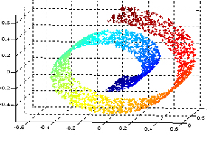
Data manifolds
The data points often reside on a low-dimensional manifold within the high-dimensional space

Slide 8
Data manifolds
Reasons:
Interdependent components of the measured data vectors
Much less degrees of freedoms in the behaviour of the underlying system than the number of simultaneous measurements
Nonlinear default geometry of the measured system

Slide 9
Approximation on the data manifold
Approximate only over the data manifold
Reduces the dimensionality of the data space
Gives better sample coverage of the data space
The expected approximation error is reduced

Slide 10
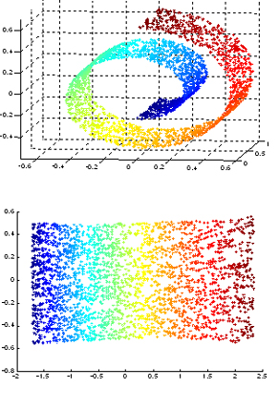
Approximation on the data manifold
Problem: we don’t know analytically what is the data manifold
Solution: project the data manifold onto a matching low-dimensional space and approximate the function over that.

Slide 11
Manifold mapping
Dimensionality estimation
Local principal component analysis
Low-dimensional mapping with preservation of topological organisation of the manifold:
Self-organising maps
Local linear embedding
Both: unsupervised learning

Slide 12
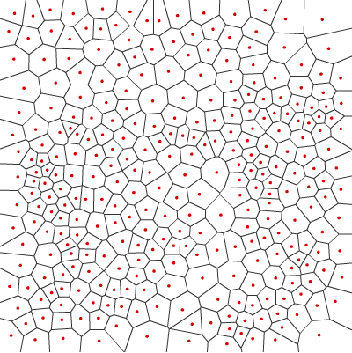
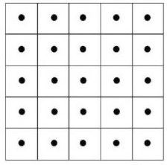
Self-organising maps
Mapping of the manifold through a Voronoi tesselation
data
nodes

Slide 13
Self-organising maps
SOM: learns the data distribution over the manifold and projects the learned Voronoi tesselation onto the low-dimensional space
The neighbourhood structure (topology) of the manifold is preserved

Slide 14
Self-organising maps
Over-complete SOM: has more nodes than the number of data points
In principle each data point may be projected to a unique node
Allows extension to unseen data points without forcing them to project to the same nodes as data points used for the learning of the mapping

Slide 15
Local Linear Embedding
r-neighbourhood of each data point

Slide 16
Local Linear Embedding
Extension for the mapping of unseen data:

Slide 17
Approximation over the projection space
Yu et al, 2009 (NIPS 2009, pp.2223-2231):

Slide 18
Approximation over the projection space
Best approximation error in the data space and the projection space:

Slide 19
Low-dimensional approximation using SOMs
Over-complete SOM for low-dimensional projection of the data manifold –
Given learn

Slide 20
Low-dimensional approximation using SOMs
Over-complete SOM: not all nodes attract a training data point
The neural network learns to generalise
Unseen data points may get attracted to such nodes

Slide 21
Low-dimensional approximation using SOMs
The SOM projection is meaningful for data points on and around the data manifold
Extension to other data points, since is defined over , is by the use of the SOM for the projection of these points as well
The SOM-based approximation of is piecewise constant (i.e. constant over each Voronoi cell in the data space)

Slide 22
Low-dimensional approximation using LLE
LLE calculation using training data
Extension to unseen data
Learning in the low dimensional space

Slide 23
Low-dimensional approximation using LLE
The LLE projection is meaningful on and around the data manifold
The extension to other data points is a continuous extension based on the LLE projection of these points

Slide 24
Approximation performance comparison
Case 1: data on 6-dimensional multiple Swiss roll manifold with 2-dimensional projections – SOM projections

Slide 25
Approximation performance comparison
10 functions – 20 data sets
Function | Formula
Squared modulus
Polynomial
Exponential square sum
Exponential-sinusoid sum
Polynomial-sinusoid sum
Inverse exponential square sum
Sigmoidal
Gaussian
Linear
Constant

Slide 26
Approximation performance comparison
RBF neural networks with 6-dimensional data and 2-dimensional projected data – z-test
Function | Performance comparison
Squared modulus | 1480.89 (1343.14); 4.09E-7
Polynomial | 134.00 (316.78); 0.02926
Exponential square sum | 4.0868 (3.2636); 1.07E-7
Exponential-sinusoid sum | 0.0679 (1.1606); 0.3967
Polynomial-sinusoid sum | 0.5997 (1.4523); 0.0323
Inverse exponential square sum | 1.0960 (1.2442); 4.08E-5
Sigmoidal | 4.5197 (5.1484); 4.36E-5
Gaussian | 2.6314 (1.7863); 2.23E-11
Linear | 23.49 (37.151); 0.0023
Constant | 0.0149 (0.0187); 0.00018

Slide 27
Approximation performance comparison
Case 2: data on 60-dimensional multiple Swiss roll manifold with 5-dimensional projections – LLE projections

Slide 28
Approximation performance comparison
10 functions – 5-dimensional extensions of the previously used 2-dimensional functions
20 data sets
RBF neural networks with 60-dimensional data and 5-dimensional projected data – t-test for comparison

Slide 29
Approximation performance comparison
Function | Performance comparison
Squared modulus | 17,467 // 7,226; 0.0457
Polynomial | 107.25 // 11.017; 0.0051
Exponential square sum | 0.0066 // 7.58E-5; 0.0252
Exponential-sinusoid sum | 0.0062 // 0.00011; 0.0071
Polynomial-sinusoid sum | 0.0056 // 3.6E-6; 0.0032
Inverse exponential square sum | 0.6708 // 0.1096; 0.0057
Sigmoidal | 254.90 // 18.001; 0.0004
Gaussian | 9.8192 // 2.8936; 0.0064
Linear | 43,189 // 2,505; 0.0297
Constant | 0.4351 // 2.76E-5; 4.21E-5

Slide 30
Extensions
The parameters of the nonlinear basis functions matter for the approximation performance of neural networks
RBF basis functions: the parameters are the centres and radii of the basis functions

Slide 31
Extensions
Support vector machine based selection of basis function parameters
Bayesian SOM learning of the data distribution in order to set the basis function parameters
Both approaches improve the approximation performance at least in a part of the considered cases

Slide 32
Issues
Error bounds on
Preservation of features of by
Local minima and maxima
Derivatives
Integrals

Slide 33
Conclusions
High-dimensional functions effectively defined over low dimensional manifolds can be approximated well through a combined unsupervised and supervised learning method
Manifold mapping methods matter for the preservation of features of the approximated function
Experimental analysis confirms expectations

