Slide 1
Network Analysis of Large-Scale software systems
Peter Andras
School of Computing and Mathematics
Keele University
p.andras@keele.ac.uk

Slide 2
Overview
Introduction
Software as network
Network analysis
Network analysis to support functional re-engineering
Assessment of joint design & implementation quality
The usefulness of method communities for software engineering
Software as model for network analysis

Slide 3
Large-scale software
100k – millions LOC (e.g. JabRef, Google Chrome, Microsoft Office, Linux)
Many developers
Development over extensive time period
Integration of many components, patches, bug fixes

Slide 4
Object oriented software
Classes → object instances
Method calls
Data exchange and passing of control between objects through calling of methods

Slide 5
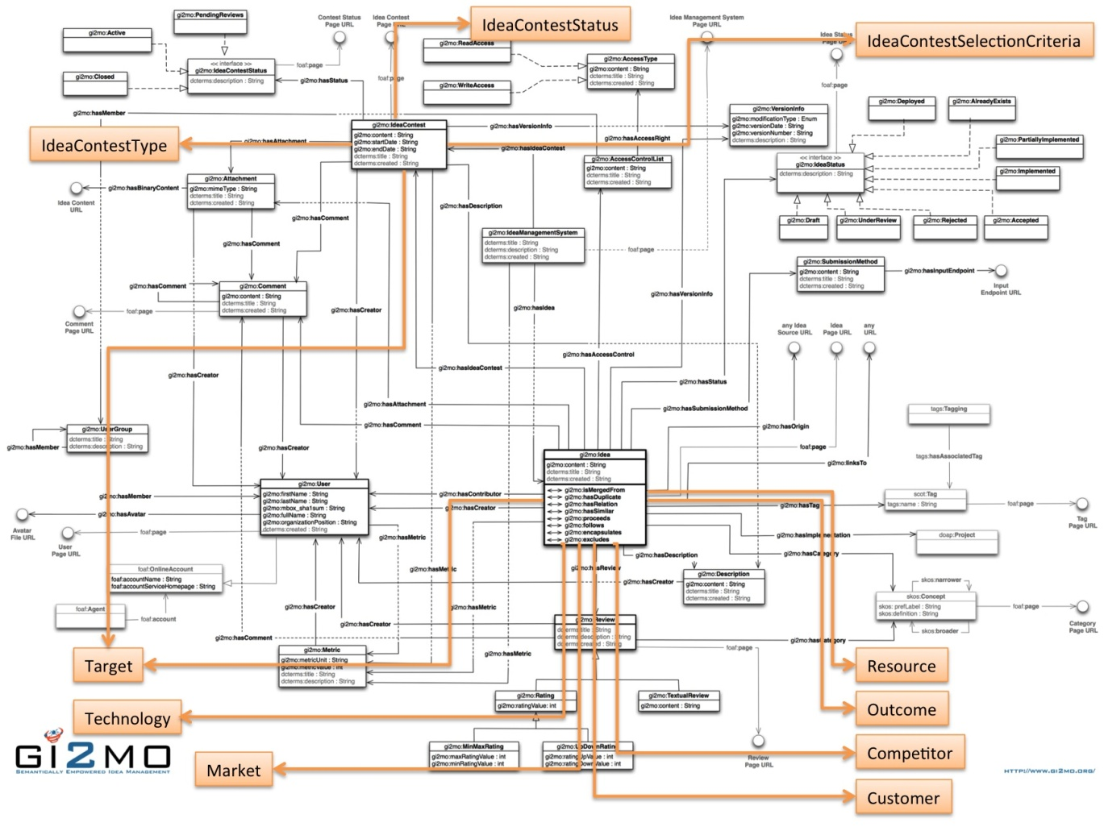
Software as a network
Static view

Slide 6
Software as a network
Dynamic view
Only some of the possible method calls are realised
Some method calls are realised more frequently than others
The range of instanciated objects and realised method calls depends on the usage scenario

Slide 7
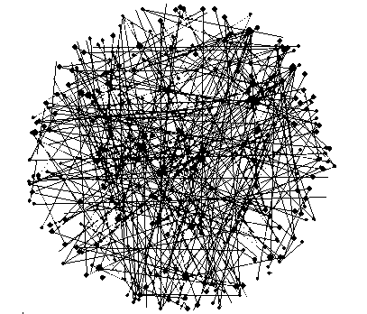
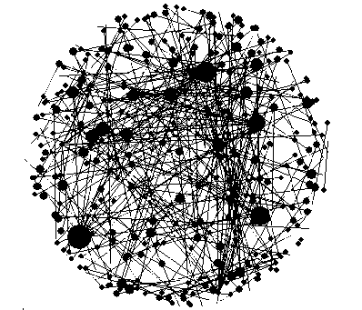
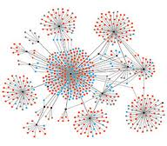
Networks
Exponential network
Scale-free network
Small world network

Slide 8
Network analysis
Assumption: scale-free connectedness distribution
Searching for structurally important components of the network

Slide 9
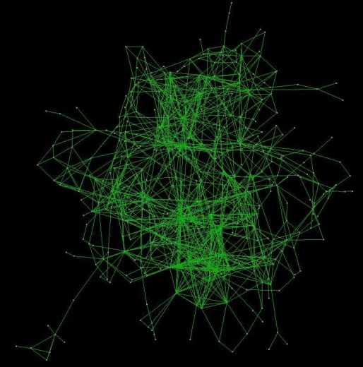
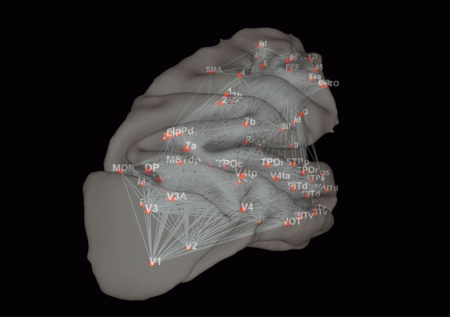
Systems as networks
System components → nodes
System component interactions → links

Slide 10
Functional importance
Concept:
The component (node, link, or some set of these) represents a part of the system that is critical for some functionality of the system
E.g. Penicilin-binding proteins for cell wall synthesis in bacteria

Slide 11
Structure – function relationships
How can we associate structural features that can be determined on the basis of the network graph with functional features that characterise the system represented by the network ?
E.g. Penicilin-binding proteins are bottlenecks in the protein-interaction network that represents the bacterium as a system of molecular interactions

Slide 12
Software network analysis to support functional re-engineering

Slide 13
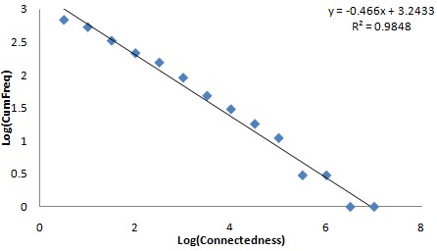
Network analysis of software
Network analysis assumption: scale-free structure → importance of structural features
Is the software represented by a scale-free network ?
Yes, large-scale software.
Test the complementary cumulative connectedness distribution

Slide 14
Functionally important method calls
User experience
Positive: desirable behaviour of the software
Negative: undesirable behaviour of the software
A method call is functionally important if it’s correct execution is critical for the positive user experience in the context of an execution scenario (e.g. delivery of a software behavioural feature)

Slide 15
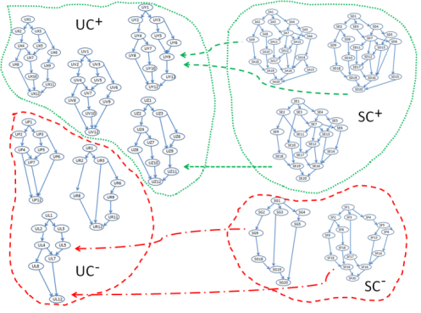
Functionally important method calls
A representation of user experience (UC+, UC–) and software execution (SC+, SC–) equivalence classes. The dashed arrows represent the mapping of software event sequences onto user event sequences. The same user event sequence may correspond to more than one software event sequences since some software events produce no user observable effect.
If a functionally important method call is altered it moves the user experience from UC+ to UC–

Slide 16
Testing functional importance
Execute usage scenario with intact software
Replace the selected method with an empty stub with the correct interface (i.e. the method can be called and returns the expected kind of output – a default output – but does not execute what’s inside of the method)
Execute the usage scenario again and assess the user experience – possibilities: no impact, minor (ignorable) effect, major (annoying) effect

Slide 17
Network metrics for software
Weighted Connection Score (WCS) of a method m represented by edges e that connect nodes n to the node representing the class of the method m, with connectedness values v(n), is calculated considering the call frequency of the method corresponding to the edge, f(e|n) as:

Slide 18
Network metrics for software
Call Frequency Score (CFS) of edges is the sum of the frequencies of calls of a method across all recorded calls of the method by all classes – f(e|n) is the frequency of the calls of the method m represented by the edge e, originating from object instances of the class represented by node n:

Slide 19
Network metrics for software
Between-ness Score (BWS) of a method m represented by edges e is the maximum betweenness score of these edges, the edge betweenness score being the number of shortest paths connecting nodes of the network that contain the edge; the length of an edge is set to be the inverse of the call frequency of the method represented by the edge:

Slide 20
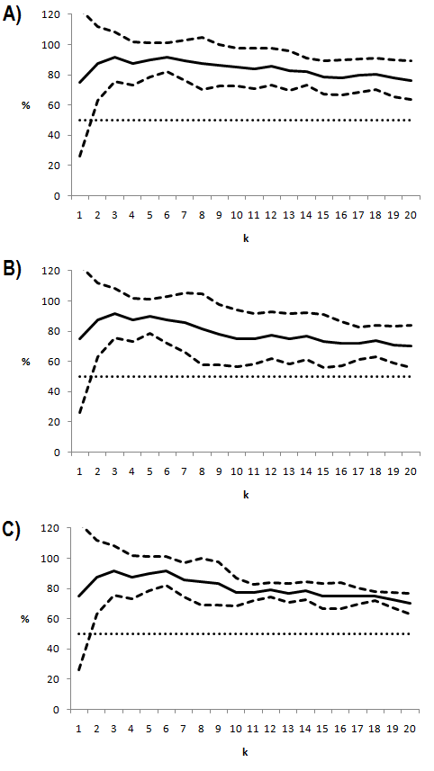
Prediction of functional importance
WCS
The accuracy of the predictions of functional importance of methods of classes by network analysis. Dashed lines show the 95% confidence bounds around the average value. The dotted line shows the expected percentage of functionally important method among a randomly chosen set of methods (50%).
CFS
BWS

Slide 21
Local dynamic network analysis to assess joint design & implementation quality of the software

Slide 22
Method stereotypes
Category |  | Stereotype | General description
Structural | Accessor | Get | Returns a local field directly
 |  | Predicate | Returns a Boolean value that is not a local field
 |  | Property | Returns information about local fields
 |  | Void-accessor | Returns information about local fields through the parameters
 | Mutator | Set | Changes only one local field
 |  | Command | Changes more than one local fields
 |  | Non-void command | Command whose return type is not void or Boolean
Creational |  | Constructor | Invoked when creating an object
 |  | Destructor | Performs any necessary cleanups before the object is destroyed
 |  | Copy-constructor | Creates a new object as a copy of the existing one
 |  | Factory | Instantiates an object and returns it
Collaborational |  | Collaborator | Connects one object with other type of objects
 |  | Controller | Provides control logic by invoking only external methods
 |  | Local- controller | Provides control logic by invoking only local methods
Degenerate |  | Abstract | Has no body
 |  | Empty | Has no statements
 |  | Incidental | Any other case

Slide 23
Implementation of methods
Given the stereotype of a method there is an expectation about the behaviour of the method (e.g. how often is it called, how many other methods and what kind of other methods are called from it)
The implementation of the software may differ from the design intentions and methods may behave differently from their intended behaviour (e.g. different call patterns)
This may lead to design & implementation mismatch impacting the quality of the software

Slide 24
Local dynamic behaviour
Fan-in & fan-out calls to and from a method – 0, 1, few (2,3,4), many (5+)
Call frequencies → flat or peaked distribution over calling/called methods → balanced / unbalanced call pattern – calculated using the Kullback-Leibler divergence (<0.3 balanced, 0.3 and above unbalanced)
Dynamic fI-fO classes
fO fI | 0 | 1 | F | M
1 | 1-0 | 1-1 | 1-FB 1-FU | 1-MB 1-MU
F | FB-0 FU-0 | FB-1 FU-1 | FB-FB FB-FU FU-FB FU-FU | FB-MB FB-MU FU-MB FU-MU
M | MB-0 MU-0 | MB-1 MU-1 | MB-FB MB-FU MU-FB MU-FU | MB-MB MB-MU MU-MB MU-MU
Notation (fI-fO) 0 = no method call 1 = a single method call FB = a few (2, 3,or 4), balanced methods calls FU = a few (2, 3,or 4), unbalanced methods calls MB = many (5 or more), balanced methods calls MU = many (5 or more), balanced methods calls
fi3
fi2
fi1
fi4
fo1
fo3
fo2

Slide 25
Dynamic behaviour and method stereotypes
In principle, a given method stereotype should have imply that methods belonging to it should have a certain local dynamic behaviour
However due to possible design & implementation inconsistency the actual behaviour of methods may differ
For each method stereotype we get a distribution over the dynamic fI-fO classes

Slide 26
The analysed software
Large open source software with publicly available execution trace data
ArgoUML (version 0.22, 924 KLOC), a UML modeling tool
muCommander (version 0.8.5, 85 KLOC), a file manager
JabRef (version 2.6, 148 KLOC), a bibliography reference manager

Slide 27
Comparing distributions
The distributions of frequency values over method stereotypes and dynamic fI-fO classes follow log-normal distributions with parameters m in [-2,0] and s in [2.2, 2.8]
Estimate expected Kullback-Leibler divergence value between such distributions and the standard deviation of such values by generating 100 such distributions randomly
Estimated mean value = 4.4838, standard deviation = 1.8117, assuming normal distribution of KL divergence values: 1% limit value is 0.2625, and 2.5% limit value is 0.9328
Calculated divergence value is considered small is less than the 3% limit value, large if it is larger than the 5% limit value, and moderately large in between.

Slide 28
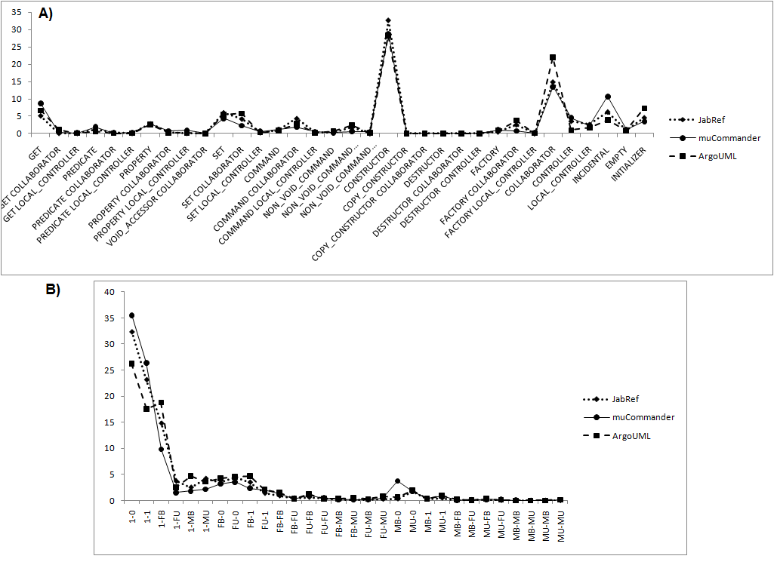
Comparing software
1% limit value is 0.2625
2.5% limit value is 0.9328
Software vs software | KL divergence
ArgoUML vs muCommander | 0.11772
muCommandervs ArgoUML | 0.24544
JabRef vs muCommander | 0.01071
muCommandervs JabRef | 0.10955
ArgoUML vs JabRef | 0.06368
JabRef vs ArgoUML | 0.05051
Software vs software | KL divergence
ArgoUML vs muCommander | 0.13181
muCommandervs ArgoUML | 0.12799
JabRef vs muCommander | 0.09463
muCommandervs JabRef | 0.07578
ArgoUML vs JabRef | 0.0529
JabRef vs ArgoUML | 0.06574

Slide 29
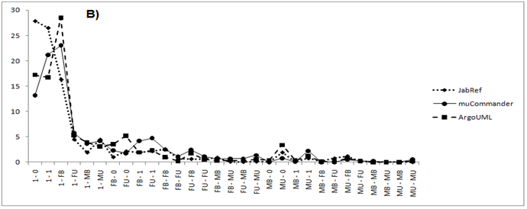
Comparing method stereotypes – same stereotype across software
Collaborator stereotype
Software vs software | KL divergence
COLLABORATOR
ArgoUML vs muCommander | 0.10024
muCommandervs ArgoUML | 0.08285
JabRef vs muCommander | 0.17379
muCommandervs JabRef | 0.12294
ArgoUML vs JabRef | 0.16617
JabRef vs ArgoUML | 0.14094

Slide 30
Comparing method stereotypes – same stereotype across software
Controller stereotype
Software vs software | KL divergence
COLLABORATOR
ArgoUML vs muCommander | 1.39183
muCommandervs ArgoUML | 2.42161
JabRef vs muCommander | 0.61756
muCommandervs JabRef | 5.10724
ArgoUML vs JabRef | 1.46486
JabRef vs ArgoUML | 0.93945

Slide 31
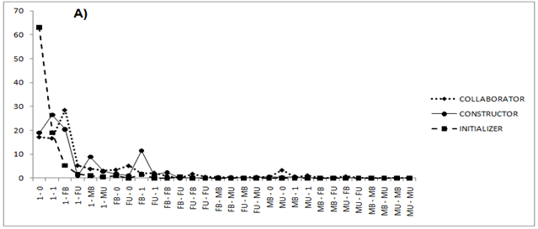
Comparing method stereotypes – different stereotypes same software
ArgoUML
 | COLLABORATOR | CONSTRUCTOR | INITIALIZER
COLLABORATOR | 0 | 0.295 | 0.339
CONSTRUCTOR | 0.306 | 0 | 0.386
INITIALIZER | 0.853 | 0.425 | 0

Slide 32
Assessing design & implementation quality
If the software is such that the dynamic fI-fO class distributions for method stereotypes are not sufficiently different, or these distributions are not sufficiently similar to the expected dynamic fI-fO class distributions, the software is likely to have a mismatch between the design intentions and the implementation of the software.
The measured design – implementation mismatch is an indicator of the software quality.
High mismatch measure indicates the need for re-engineering.

Slide 33
The usefulness of method communities for software engineering

Slide 34
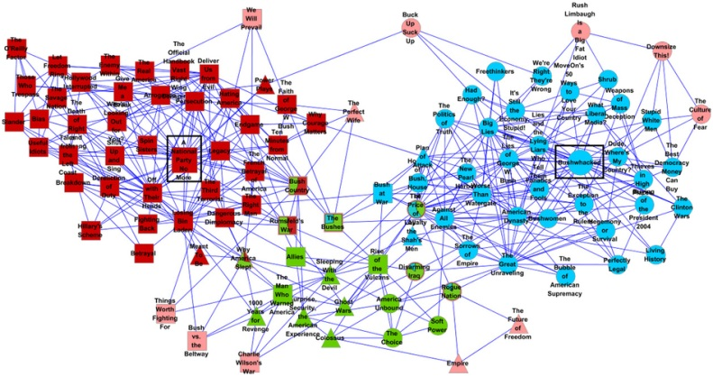
Network communities
Social networks → social communities
E.g. friends, co-workers, ethnic groups
Generalisation: a collection of nodes that cluster together and have some functional similarity (in a general sense)
(www.nature.com/srep/2013/131021/srep02993/fig_tab/srep02993_F3.html)

Slide 35
Method communities
Dynamic analysis data → method – to – method calls network, methods as nodes
Community detection algorithms can detect method communities
Do these method communities make any sense? Are they useful?

Slide 36
Community detection
Louvain algorithm
The result is a set of hierarchically organised communities, each node belonging to a single community at each level of the hierarchy

Slide 37
Software data
Large open source software with publicly available execution trace data
ArgoUML (version 0.22, 924 KLOC), a UML modeling tool
muCommander (version 0.8.5, 85 KLOC), a file manager
JabRef (version 2.6, 148 KLOC), a bibliography reference manager
Method stereotype classification of methods

Slide 38
What is associated with method communities?
Analysis of dominant method stereotype and class distribution of methods belonging to communities
Method stereotype is not associated with communities – exceptions are communities of constructors
Functionality indicated by class label and method name is associated with communities

Slide 39
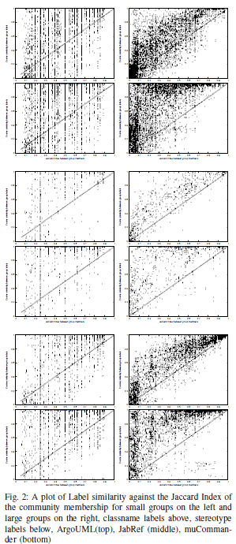
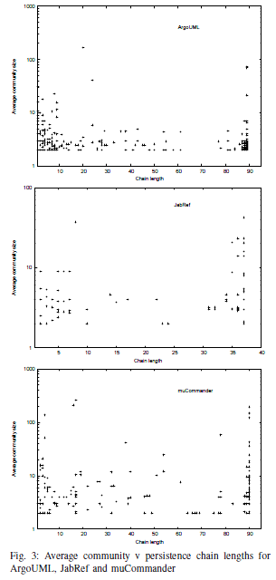
Community preservation
Network communities may change in terms of methods belonging to them, but their distribution over class labels and method stereotypes is preserved
Most communities are either preserved over many traces or present in only a few execution traces

Slide 40
Usefulness of method communities
Functionality association with method communities that transcends class belonging
Long and short preservation communities, and especially in the case of large communities, may reveal important functionality related aspects of the software
Community preservation patterns may have implications in terms of software quality

Slide 41
Software as an experimental model for complex network analysis

Slide 42
Software as a model for network analysis
Dynamic analysis of large scale software
Large scale networks of class / object interactions that change depending on the usage scenario and context
Cheap generation of large volume data about real and functional systems that have representations as large complex networks
Usually network data about real world systems is expensive to generate, may raise ethical issues, or it is based on proprietary data from companies

Slide 43
Network experiments
Due to the expensive nature of usual real world network data, it is even more expensive to conduct real experiments on the real systems to test the validity of network theories and analysis methods – it is common to rely on testing these on surrogate data generated computationally by assuming some underlying abstract properties of the real systems
Example: testing potential novel antibiotic targets predicted using network analysis methods took 2 years of postdoc time, required expensive equipment and expensive consumables, and led to the conclusion that the predictions were not as good as expected

Slide 44
Network experiments
Large scale software can be used to set up relatively cheaply controlled experiments about the software – these experiments generate data about the behaviour of the corresponding complex networks under the experimental conditions
The software experiments can be repeated many times with relatively low labour, time and resource costs, to generate sufficient volume of data for statistically valid evaluation

Slide 45
Evaluation & validation of network analysis methods
Experiments can be designed to allow the testing the validity of claims about network analysis methods and to evaluate the extent of usefulness of such methods
The software having well defined functionality allows the evaluation of the effective functional relevance / impact of the network analysis methods – general validity check: are these methods useful for software engineering to improve the quality of the software
Example: testing the effectiveness of network metrics for prediction of functional importance of methods

Slide 46
Opportunities
The field of network science and the applications of network science are rapidly growing
Currently there is very little opportunity to validate network analysis methods using real data – the validation based on surrogate data is questionable due to the assumptions that are used to generate such data
Experiments about networked complex systems using large-scale software can fill the experimental validation gap in network science and its applications

Slide 47
Summary
Large-scale software can be represented as a complex network, and dynamic analysis of such software can generate large volume of network data relatively cheaply
Large-scale software can be used to evaluate and validate network analysis methods and network theories
Network metrics can predict functionally important method calls – an example of validation study of network analysis methods
Combined dynamic and static analysis and evaluation of local dynamic network properties can provide an assessment of software quality in terms of measuring design & implementation mismatch

Slide 48
Acknowledgements
Keele University
Boyd Duffee (PhD student)
Newcastle University:
Anjan Pakhira (PhD student)
Jonathan Barkass (PhD student)
Wayne State University:
Andrian Marcus (PI)
Laura Moreno (PhD student)

